Slide 1

Welcome to Year 3!
Miss Curtis (Y3 Lead)
Miss Fatania
Mrs Renner-Thomas
Mrs Kelly ( Tuesday)

Slide 2
REMINDERS
School starts at 8:45 and finishes at 3.30pm.
We are a uniform school! PE will be on Monday and Friday, please come in wearing your school PE kit (Stillness tracksuit/plain navy blue tracksuit/plain white t-shirt, navy or black shorts and plain black trainers)
Please check the school’s website for the weekly round up, letters and information about the curriculum.

Slide 3
Reading
Children have been issued with a Reading Scheme reading book. This should come in to school every day and in to the classroom. Please read this with them at home and write a comment in the Reading Record.
Children have borrowed a reading for pleasure book from the library which can be read to them or with them. Year 3 go to the library on a Monday or Tuesday and will have the chance to change their books.

Slide 4
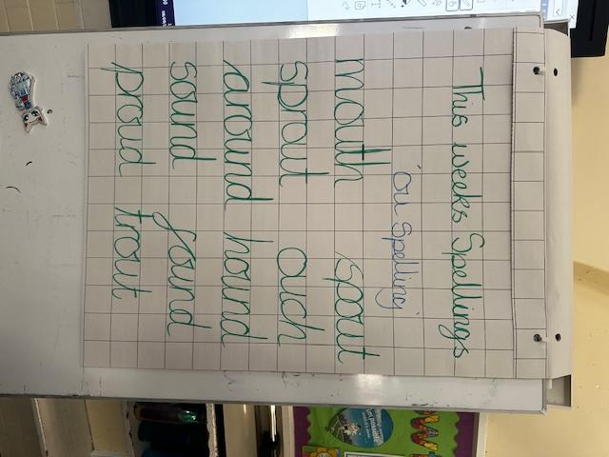
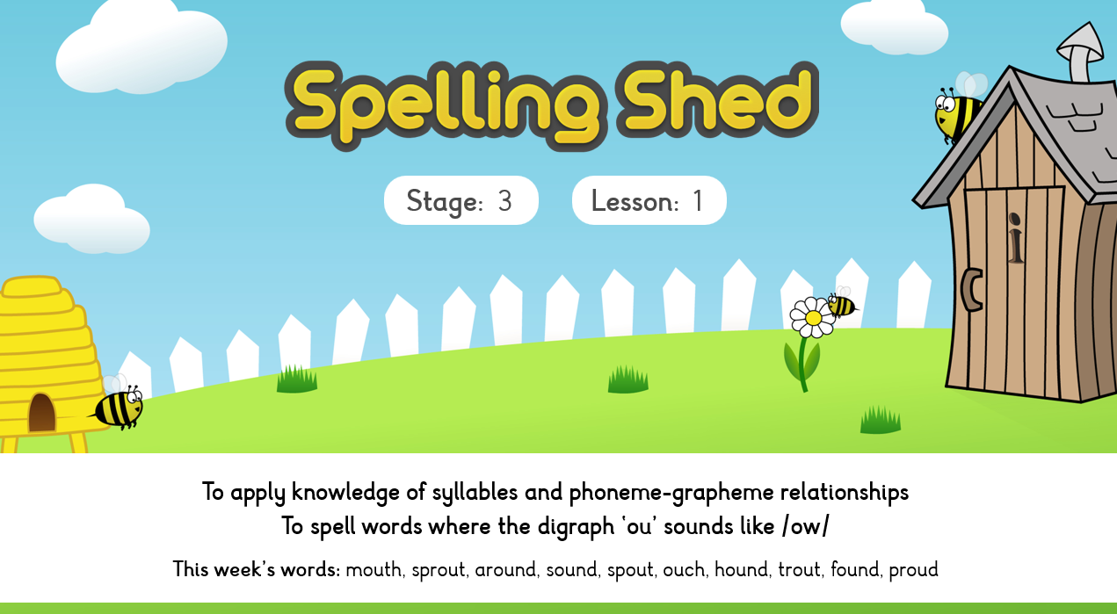
Spellings – Spelling Shed

Slide 5
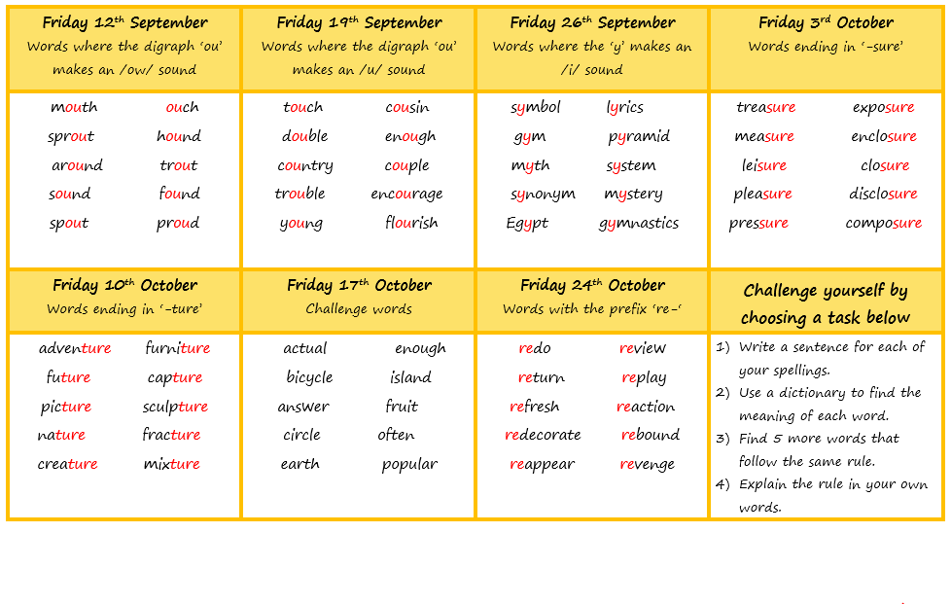
Spellings
The children will be given 10 spellings each week to learn in school and at home
Most set of spellings will follow a phonic or grammar rule
Every Friday the children will complete a spelling test in their English book
Week 1
The spelling document can be found on the school website in the English section.

Slide 6
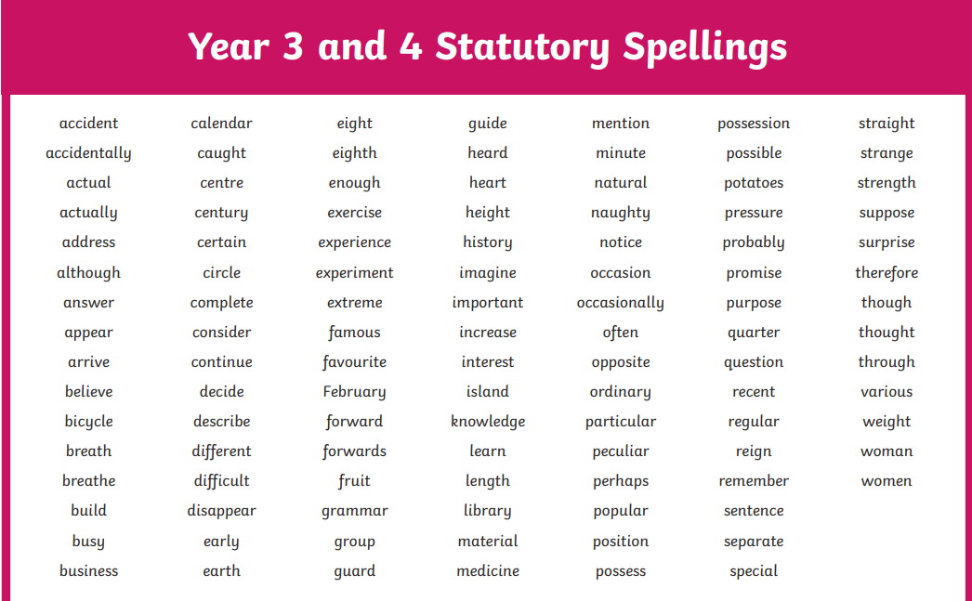

Slide 7

SUPPORT AT HOME (homework)
Daily reading and more reading!
Spelling practice – shared on Monday with a test on a Friday
(10 spellings a week)
TT Rockstars (children have been given log ins)
Times Table practice – you can practice on the way to school, before bed, at breakfast etc.
Duolingo
Look through the Knowledge Organisers – located on the school’s website
Enjoy the experiences our community has to offer and talk about them!
Please check the Year 3 curriculum letter for the Termly project.
Need help resources can be found on Google Classroom.

Slide 8
Roles and Responsibilities
Eco-warriors
First aiders
Well-being champions
Librarians
PE Monitor
Digital Leader
Classroom/Teaching Assistant Monitors
School Council Reps

Slide 9
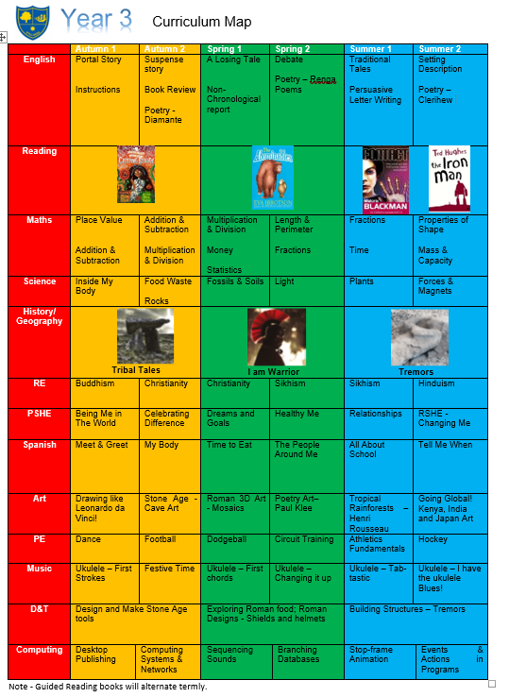
Curriculum Map
(see website)

Slide 10




Guided Reading Texts

Slide 11







PE/Sporting Events
Coach Perry
Coach Joe

Slide 12
Potential extra curricular this year…
Cats protection workshop
Football training with the Tottenham coaches
Rocks, Fossils & Soils Workshop
DT workshop to the V&A Museum
Dress up days
Horniman museum to learn about ancient Britain
Pantomime at Catford Broadway
Science Museum
Mitcham Zoo animal workshop
RE trips to churches and temples
Volcano building
Various DT projects in house

Slide 13
Class mixing
All year groups will be mixed at the end of each academic year.
This allows us to refocus learning groups. Classes change over time, children mature, friendships change, children leave and others join. Mixing the classes allows children to be with different children and ensures community across year groups.
Our class mixes have been overwhelmingly positive. Teachers work together taking gender, ability, SEND, behaviour and friendships into account.

Slide 14
COMMUNICATION y3@stillnessjs.lewisham.sch.uk admin@stillnessjs.lewisham.sch.uk

Slide 15
Questions?

Slide 16
Assessment
We have 3 Assessment points per academic year: Autumn, Spring and Summer
In Year 3 we have an additional baseline in the first month of Year 3.
Baseline: Children sit the KS1 SATs papers in Reading and Maths and we assess a piece of writing
Autumn: Week beginning 25th November children sit NFER papers in Reading and SPaG, White Rose Maths and we assess a piece of writing
Spring: Week beginning 10th March children sit NFER papers in Reading and SPaG, White Rose Maths and we assess a piece of writing
Summer: Week beginning 23rd June children sit NFER papers in Reading and SPaG, White Rose Maths and we assess a piece of writing

Slide 17
Assessment
Attainment: is the mark/level the child has achieved in the assessment.
At Stillness we use the following levels:
WTS – Working towards age-related expectations
EXP – Working at age-related expectations
We do not use GD – Greater Depth in Years 3-5 as there is no official GD in those year groups. The only year groups where there is a definition of working at greater depth is in Year 2 and Year 6 where there are statutory assessments.
Progress: is the progress made from the child’s individual starting point. There will be no progress measure on the Autumn reports as progress is measured from Autumn to the following term.
0 denotes Expected progress
+ a positive number denotes accelerated progress
a negative number denotes some progress
Your child’s attainment and progress will be discussed with you at Parents Evening.

Slide 18
Questions?

Slide 19
Pupil Premium Funding
The Pupil Premium Grant (PPG) is an allocation of additional funding from central government provided to schools to support specific groups of children who are vulnerable to possible under achievement. Those who are eligible for the grant include pupils who are entitled to free school meals (FSM), those looked after by the local authority (LAC), from households with no recourse to public funds (NRPF) and the children of armed service personnel.
You are entitled to FSM if the following applies to you:
your combined annual household income is below £16,190 (as assessed by HMRC) and you get one of the following benefits:
income-based: income support or jobseeker’s allowance (not eligible if on contribution based jobseeker’s allowance)
income-related: employment support allowance (not eligible if on contribution based employment support allowance)
universal credit
income support
the guaranteed element of state pension credit
support under Part VI of the Immigration and Asylum Act 1999
child tax credit only.
No recourse to public funds (NRPF) parents

Slide 20
Questions?

