Slide 1

Welcome to Year 4!
y4@stillnessjs.lewisham.sch.uk
Miss Rooney (Parbury Class teacher and Y4 Lead)
Mrs Chisholm (Sevenoaks Class teacher)
Mr Baxter (Ivy Class teacher)
Mrs Renner-Thomas (Deputy Head and Assessment Lead)

Slide 2
REMINDERS
School starts at 8:45 and finishes at 3:30pm.
PE will be on Tuesday and Thursday.
We visit the library as a class every Tuesday. Y4 children can visit the library at lunchtime every Thursday.
Please check the school’s website for letters and information about the curriculum.

Slide 3






We are a uniform school!
Our school uniform consists grey skirts, culottes, trousers or shorts. Royal blue or yellow polo shirt, sweatshirt or fleece with or without the school logo. Children may wear blue or yellow check summer dresses. All pupils must wear black shoes or all black trainers.
PE will be on Tuesday and Thursday. Children should come in wearing their school PE kit; white t-shirt, navy or black shorts, navy or black tracksuit and black trainers (with or without the school logo).
Children with hair longer than their shoulders should have it tied back and children should not wear any jewellery with the exception of watches and stud earrings.
Uniform

Slide 4




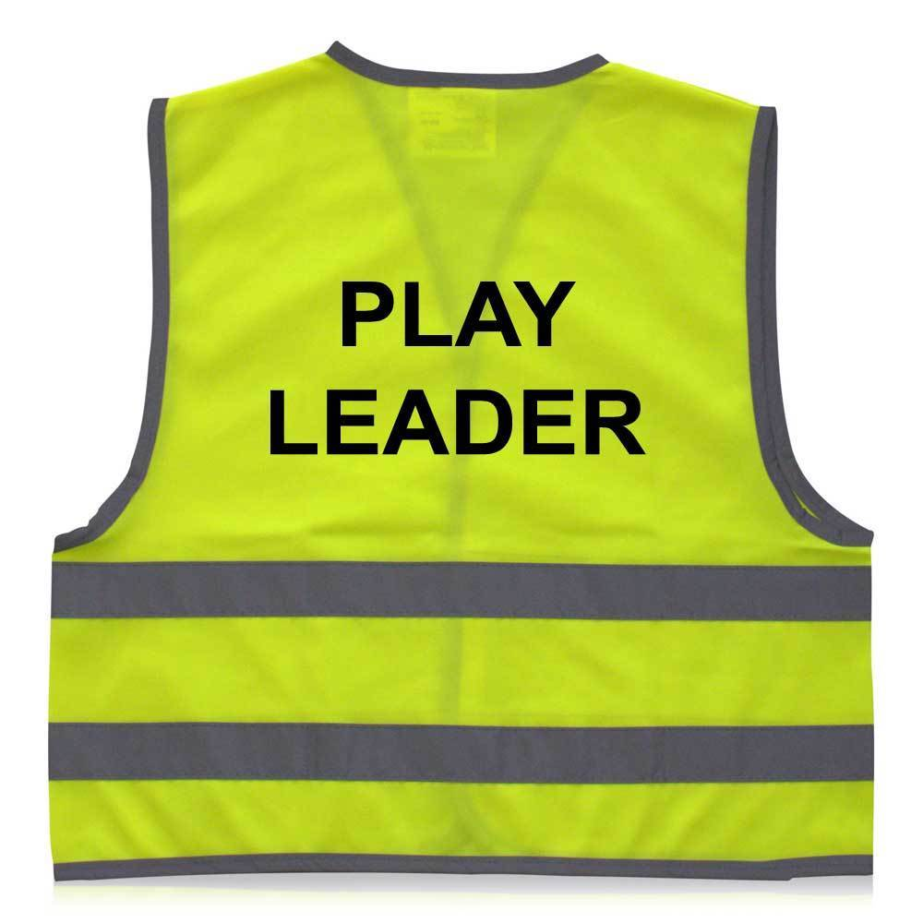
Roles and Responsibilities
At Stillness Junior School we have a number of roles and responsibilities at the school. At the beginning of the year we will speak to the children about the different roles and what their responsibility would be.
School Council
Play Leader
Librarian
PE Monitor
Music Monitor
First Aider
Computer Monitor
Wellbeing Champion
In class job roles

Slide 5
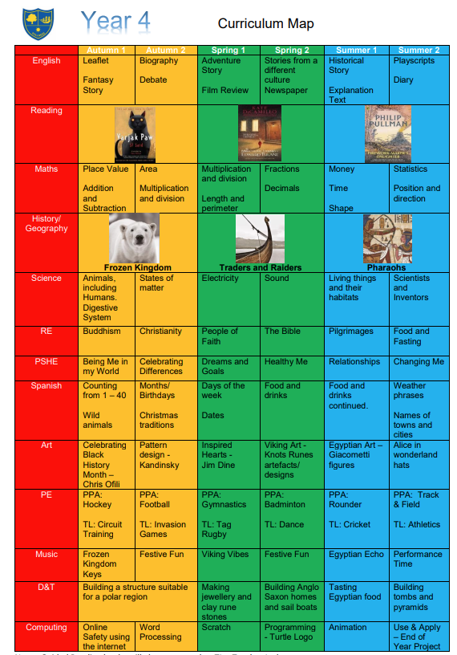
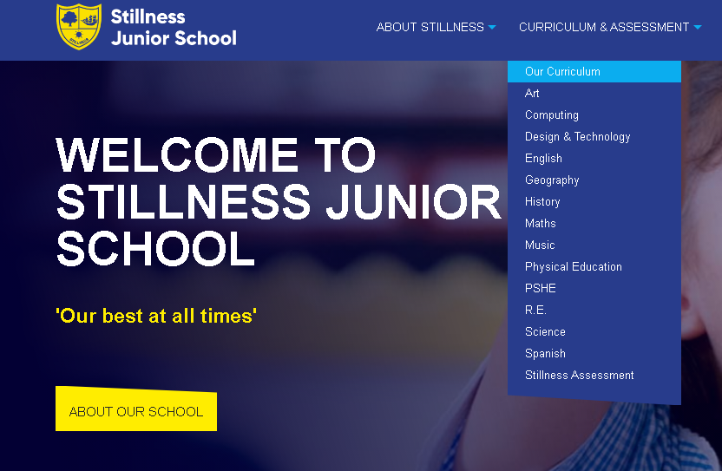
Curriculum Map
In Y4 we have high expectations of all our pupils to achieve to the best of their ability.
Our main goal is that all children are exposed to a broad and engaging curriculum.

Slide 6
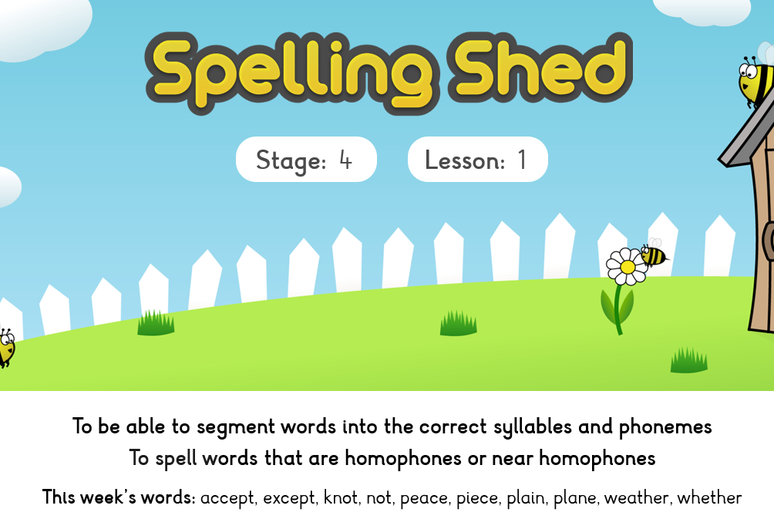
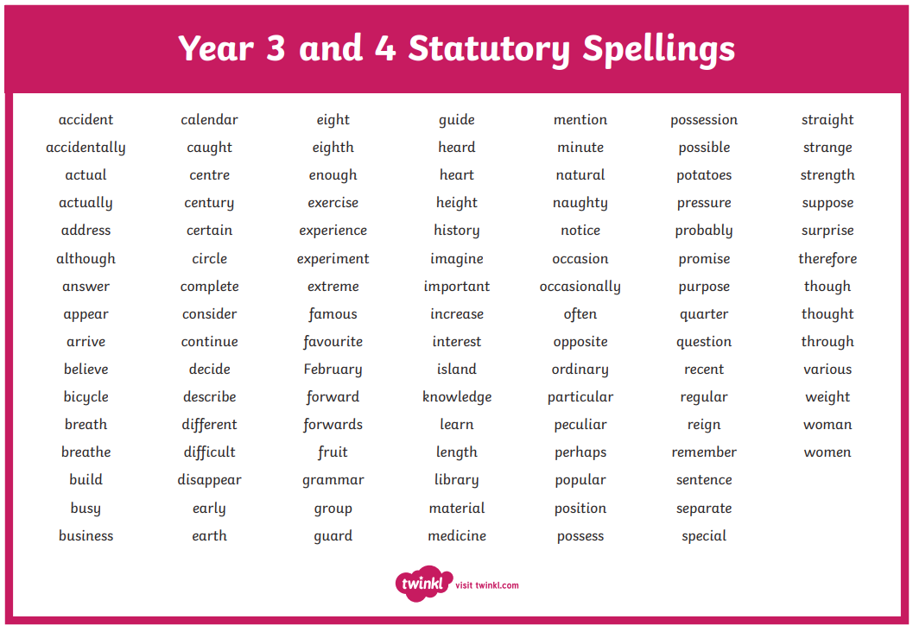
Spellings
In class we have a spelling activity at the start of each day.
The weekly spellings are displayed in the classroom.
We encourage children to practise their spellings at home so they are ready for the test on Friday.

Slide 7
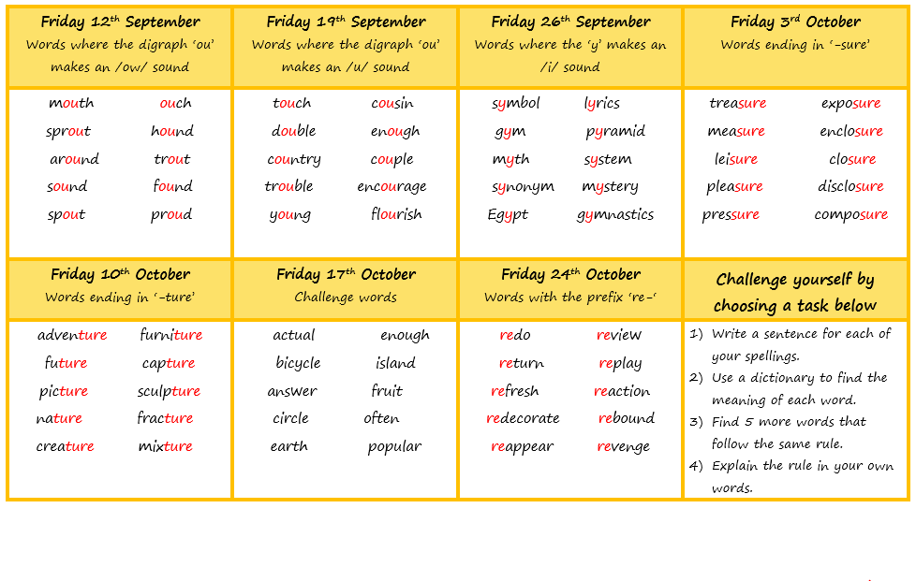
Spellings - Changes
The children will now be given 10 spellings each week to learn in school and at home.
Most sets of spellings will follow a phonics or grammar rule.
The children will still complete a spelling test in their English book every Friday.
The spelling document will be on the school website in the English section.

Slide 8





Guided Reading
Guided reading sessions will be based around these texts.
We start the week by reading a chapter of the book and we have a class discussion.
For the rest of the week, the children will answer VIPERS questions about the chapter they have read.

Slide 9
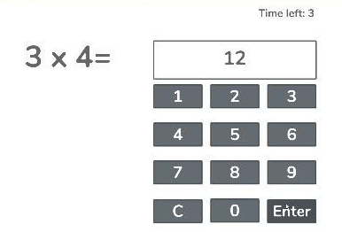
Multiplication Timetables Check (MTC)
In June all eligible Y4 children will be completing their MTC.
Children will be using chrome books
3 practise questions
25 questions
6 seconds to answer each question
The questions will only be multiplication and go up to 12x12
The results are not published publicly and there’s no pass or fail. The children will be told their score out of 25 in their Summer report.
x2 | x5 | x10 | x4 | x8 | x3 | x6 | x9 | x7 | x11 | x12
Suggested order to learn the tables (every child is different)

Slide 10
Multiplication Timestables Check (MTC)
Things we are doing in school
Times tables are taught weekly
TTRS is used weekly during our computing day
Early morning work focused on a specific times table
Children complete a Mock MTC each term
Things you can do at home
Encourage your child to use TTRS at home
Quiz your child regularly and at random on their times tables. This could be done whilst cooking, during car journeys or walking to school.
Use songs, games or rhymes to remember the tables
Challenge your child to ‘beat the adult’

Slide 11

SUPPORT AT HOME
Daily reading for at least 10 minutes.
Practise weekly spellings
TTRS
Look through the Knowledge Organisers – located on the school’s website
Enjoy the experiences our community has to offer and talk about them!
Please check the Y4 curriculum letter for the termly topic project.

Slide 12
Class mixing
All year groups will be mixed at the end of each academic year.
This allows us to refocus learning groups. Classes change over time, children mature, friendships change, children leave and others join. Mixing the classes allows children to be with different children and ensures community across year groups.
Our class mixes have been overwhelmingly positive. Teachers work together taking gender, ability, SEND, behaviour and friendships into account.

Slide 13
Potential extra curricular this year…
Football training with the Tottenham coaches
The Horniman museum to learn about Arctic life
The Maritime museum to learn about the Vikings
The British Museum to learn about Ancient Egypt
RE visits to a local synagogue, church and gurdwara
The Centre of the Cell to learn about the digestion system
Dress up days
Pantomime at Catford Broadway
Various D&T projects and Science investigations in school

Slide 14
COMMUNICATION
y4@stillnessjs.lewisham.sch.uk
admin@stillnessjs.lewisham.sch.uk

Slide 15
Questions?

Slide 16
Assessment
We have 3 Assessment points per academic year: Autumn, Spring and Summer
Autumn: Week beginning 25th November children sit NFER papers in Reading and SPaG, White Rose Maths and we assess a piece of writing
Spring: Week beginning 10th March children sit NFER papers in Reading and SPaG, White Rose Maths and we assess a piece of writing
Summer: Week beginning 23rd June children sit NFER papers in Reading and SPaG, White Rose Maths and we assess a piece of writing

Slide 17
Assessment
Attainment: is the mark/level the child has achieved in the assessment.
At Stillness we use the following levels:
WTS – Working towards age-related expectations
EXP – Working at age-related expectations
We do not use GD – Greater Depth in Years 3-5 as there is no official GD in those year groups. The only year groups where there is a definition of working at greater depth is in Year 2 and Year 6 where there are statutory assessments.
Progress: is the progress made from the child’s individual starting point. There will be no progress measure on the Autumn reports as progress is measured from Autumn to the following term.
0 denotes Expected progress
+ a positive number denotes accelerated progress
a negative number denotes some progress
Your child’s attainment and progress will be discussed with you at Parents Evening.

Slide 18
Questions?

Slide 19
Pupil Premium Funding
The Pupil Premium Grant (PPG) is an allocation of additional funding from central government provided to schools to support specific groups of children who are vulnerable to possible under achievement. who are eligible for the grant include pupils who are entitled to free school meals (FSM), those looked after by the local authority (LAC), from households with no recourse to public funds (NRPF) and the children of armed service personnel.
You are entitled to FSM if the following applies to you:
your combined annual household income is below £16,190 (as assessed by HMRC) and you get one of the following benefits:
income-based: income support or jobseeker’s allowance (not eligible if on contribution based jobseeker’s allowance)
income-related: employment support allowance (not eligible if on contribution based employment support allowance)
universal credit
income support
the guaranteed element of state pension credit
support under Part VI of the Immigration and Asylum Act 1999
child tax credit only.
No recourse to public funds (NRPF) parents

Slide 20
Questions?

