Slide 1


Welcome to Year 5!
Ms Gayer (Y5 Lead)
Mr Sloan
Ms Zelve (Maths)

Slide 2
School starts at 8:45am and we dismiss at 3.30pm. If you would like your child to walk home alone – you must complete the online form for the office. This form needs to be completed both at the beginning of Y5 and then again at the beginning of Y6 so we are sure we have in date consent for your child.
The behaviour system remains the same, with children being awarded a house point for demonstrating the agreed behaviour expectations.
As many children walk home by themselves, we understand that parents want to be able to be in contact with children. However, please note that we have a no phone policy for safeguarding purposes. If pick-up arrangements change, please contact the office.
PE on Mondays and Wednesdays
Expectations and Routines
Homework will start from Autumn 2 term on google classroom we will set the following weekly:
English, Reading and Maths
Topic- set termly (See curriculum newsletter)
Spellings- set on Monday, tested on Friday. (See website for list)

Slide 3



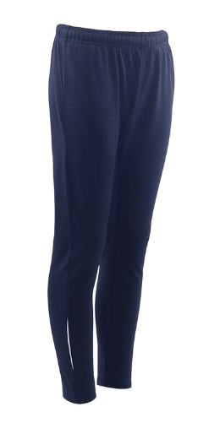


We are a uniform school!
Our school uniform consists grey skirts, culottes, trousers or shorts. Royal blue or yellow polo shirt, sweatshirt or fleece with or without the school logo. Children may wear blue or yellow check summer dresses. All pupils must wear black shoes or all black trainers. These can be purchased from M&S or Goodies.
PE will be on Monday and Wednesday, please come in wearing your school PE kit; white t-shirt, navy or black shorts, navy or black tracksuit and black trainers (with or without the school logo).
Note – During Sports Day, children will be asked to wear a t-shirt representing the colour of their house.
Children with hair longer than their shoulders should have it tied back and children should not wear any jewellery with the exception of watches and stud earrings.
Uniform

Slide 4




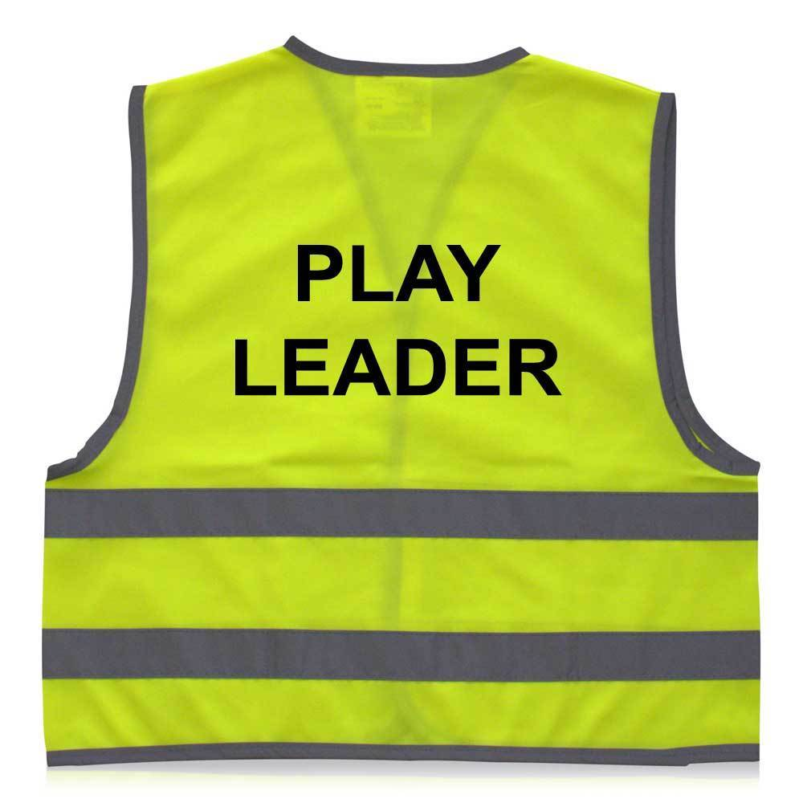
Roles and Responsibilities
At Stillness Junior School we have a number of roles and responsibilities at the school. At the beginning of the year we will speak to each children about the different roles and what that intakes so they are aware of the responsibility for that role.
School Council
Play Leader
Librarian
PE Monitor
Eco warrior
Digital leader
First Aider
Wellbeing Champion
In class job role

Slide 5
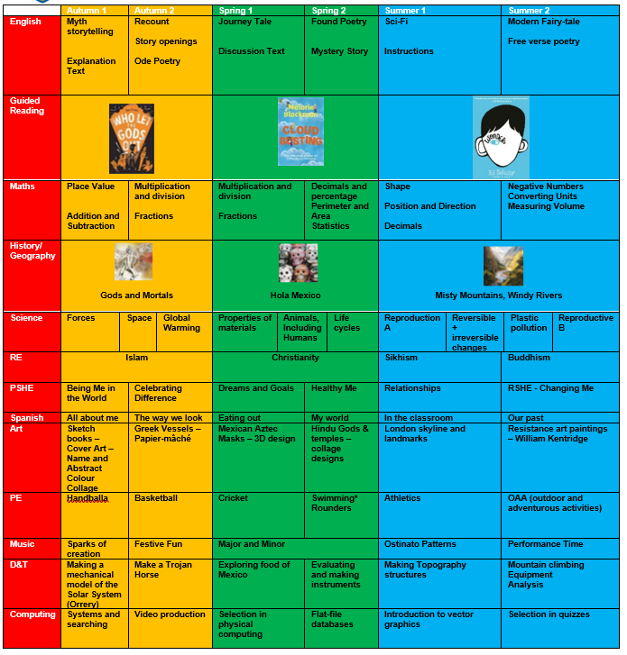
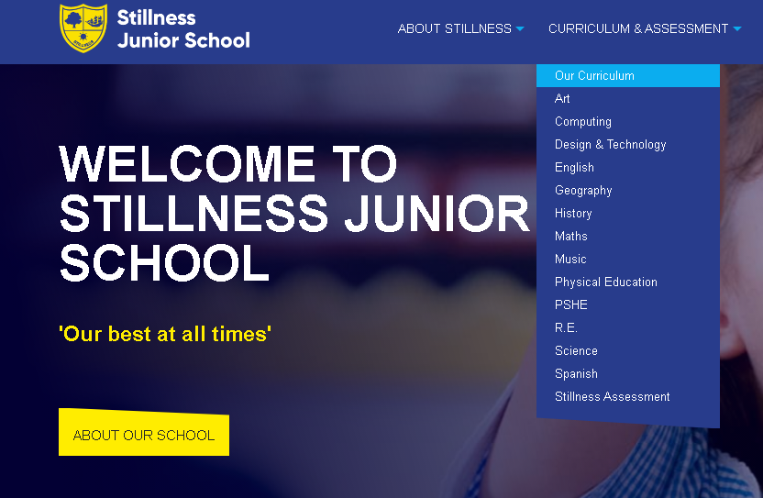
Curriculum Map
(see website)
Year 5 is a rigorous year, and we have high expectations of all our pupils to achieve to the best of their ability.
Our main goal is that all children are exposed to a broad and engaging curriculum and leave us as well prepared for secondary school as possible.

Slide 6
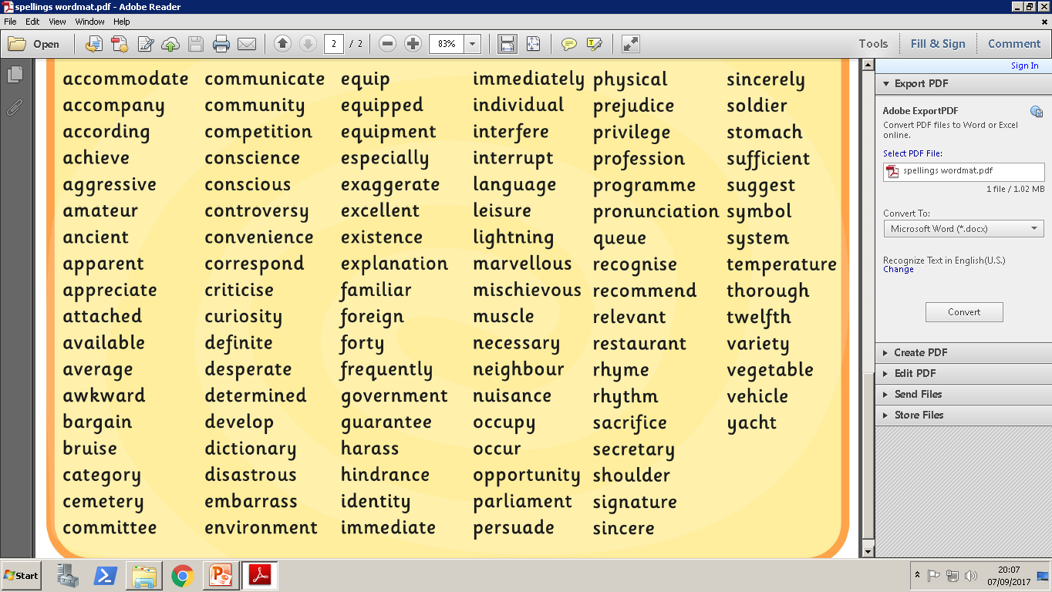
Year 5/6 word list

Slide 7
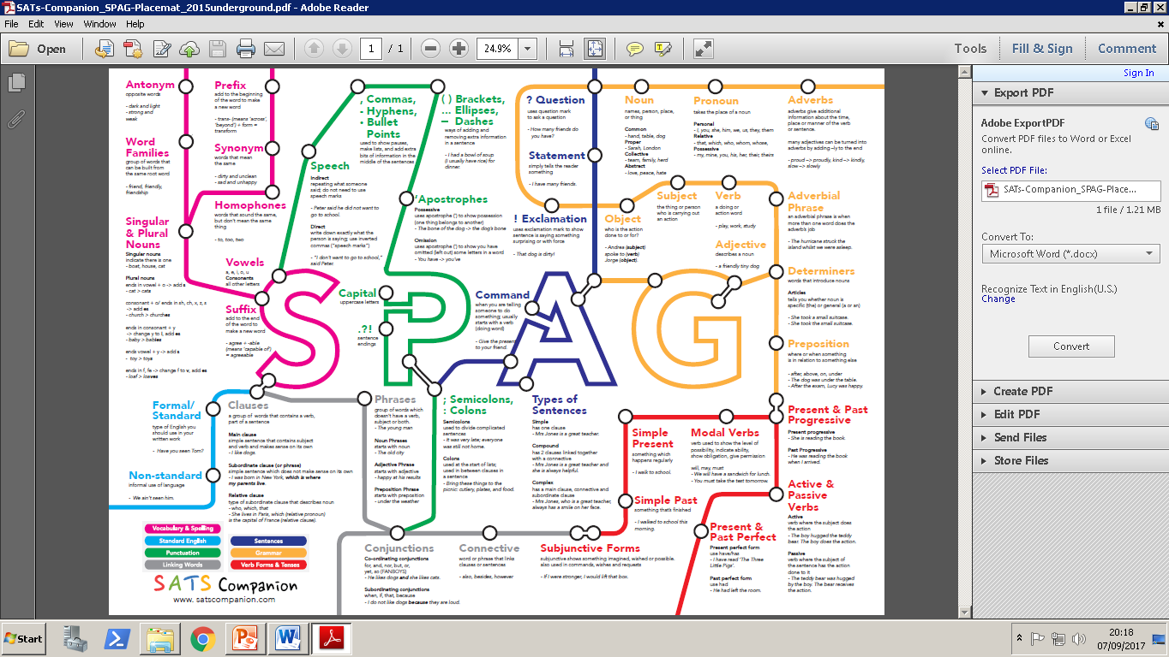
Spelling, Punctuation and Grammar

Slide 8



Guided Reading Texts
Guided reading sessions will be based on the above books. We aim to get through all three by the end of the year. In addition to guided reading sessions in school, we expect daily reading at home, preferably with an adult for some of those times. We encourage children to challenge themselves with the books they read at home and read a wide variety of genres.

Slide 9





PE/Sporting Events
Coach Perry
Coach Joe

Slide 10
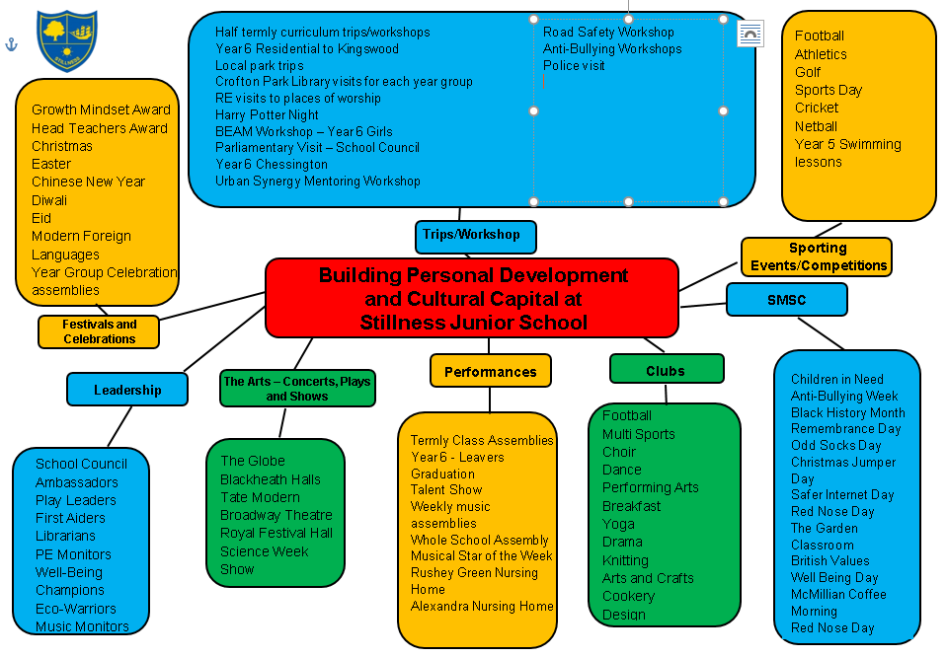
Cultural Capital
Autumn Trips/Activities
Foxborough William Mitchel Mural Community Project
British Library
Lewisham Islamic Centre
Ladywell Boat Racing
PE coaches
Tottenham coaches
Islamophobia workshop
Trojan Horse Building
Pantomime
Spring Trips/Activities
Swimming
Horniman Museum
Hindu Temple
Make a Piñata
World Book Day
Summer Trips/Activities
Lewisham Food Bank
Deptford Creek
Sports Day
Arts and Culture Night
Y5 End of Term Picnic
We are kindly requesting contributions to cover the cost of the trips.

Slide 11

Daily reading and more reading!
Weekly maths, reading and English tasks set on Google Classroom (from autumn 2)
Spellings – See website for list
TT Rockstars
Duolingo
Look through the Knowledge Organisers – located on the school’s website
Enjoy the experiences our community has to offer and talk about them!
Please check the Year 5 curriculum letter for the Termly project.
Support at home

Slide 12
Questions?
y5@stillnessjs.lewisham.sch.uk

Slide 13
Assessment
We have 3 Assessment points per academic year: Autumn, Spring and Summer
Autumn: Week beginning 24th November children sit NFER papers in Reading and SPaG, White Rose Maths and we assess a piece of writing
Spring: Week beginning 9th March children sit NFER papers in Reading and SPaG, White Rose Maths and we assess a piece of writing
Summer: Week beginning 22nd June children sit NFER papers in Reading and SPaG, White Rose Maths and we assess a piece of writing

Slide 14
Assessment
Attainment: is the mark/level the child has achieved in the assessment.
At Stillness we use the following levels:
WTS – Working towards age-related expectations
EXP – Working at age-related expectations
We no longer use GD – Greater Depth in Years 3-5 as there is no official GD in those year groups. The only year groups where there is a definition of working at greater depth is in Year 2 and Year 6 where there are statutory assessments.
Progress: is the progress made from the child’s individual starting point. There will be no progress measure on the Autumn reports as progress is measured from Autumn to the following term.
0 denotes Expected progress
+ a positive number denotes accelerated progress
a negative number denotes some progress
Your child’s attainment and progress will be discussed with you at Parents Evening.

Slide 15
Here at Stillness Junior School we use a wide variety of communication tools to keep everyone informed.
Program of Events: This is a detailed document outlining the trips that compliment our program of study.
Curriculum Letter: This termly communication from Year Group Leaders highlights specific information about the curriculum content.
Monthly Newsletter: This will be emailed out to you on the first day of the month. This will also contain a section on OPAL every month.
Leadership Update: This is a weekly communication from Mrs Nichol, Headteacher and will be sent out every Monday. This communication will cover the upcoming week including events planned for the week.
Special Edition Newsletters: You will receive one newsletter a year from each subject leaders sharing information and resources about their subject.
Communication at Stillness

Slide 16
Questions?
y5@stillnessjs.lewisham.sch.uk

Slide 17
Secondary Transfer
y5@stillnessjs.lewisham.sch.uk
Although it seems early to discuss this some dates and information are important for Y5.
If you are considering Grammar Schools, please refer to the website of the borough you are looking at as the registration dates for the 11+ tests are usually in the May of Y5.
https://www.kent.gov.uk/education-and-children/schools/school-places/kent-test
https://www.bexley.gov.uk/services/schools-and-education/selection-tests/register-secondary-selection-test
As Lewisham is not a selective borough we are unable to advise about selective tests and there are elements of the testing process which are not in the National Curriculum.
All of the information you will need for applying to a secondary school is on the Lewisham website:
https://lewisham.gov.uk/myservices/education/schools/school-admission/applying-to-start-secondary-school
The dates of the open evenings and days come quite early in the Autumn Term of Y6 so make sure you are looking out for the dates. We are happy for you to take your child out for these events – please email the office with a list of the dates you are taking your child so we can make sure the correct code is applied to the register.

Slide 18
Secondary Transfer
y5@stillnessjs.lewisham.sch.uk
When you are thinking of secondary schools, please refer to their admissions criteria as these are applied strictly. Do not put a school down where you are outside of the area for example as you will not get a place and will have wasted one of your choices.
Please do not put down a school that you would not like your child to attend. Any school on your list could be the one that your child is placed in.
Tips
Visit as many schools as you can both during the day and after school
Ask lots of questions – which would best suit your child?
Use all 6 choices
Check the admission criteria before applying to any school especially Faith/Selective schools
Let us know when you are visiting schools

Slide 19
Pupil Premium Funding
The Pupil Premium Grant (PPG) is an allocation of additional funding from central government provided to schools to support specific groups of children who are vulnerable to possible under achievement. Those who are eligible for the grant include pupils who are entitled to free school meals (FSM), those looked after by the local authority (LAC), from households with no recourse to public funds (NRPF) and the children of armed service personnel.
You are entitled to FSM if the following applies to you:
your combined annual household income is below £16,190 (as assessed by HMRC) and you get one of the following benefits:
income-based: income support or jobseeker’s allowance (not eligible if on contribution based jobseeker’s allowance)
income-related: employment support allowance (not eligible if on contribution based employment support allowance)
universal credit
income support
the guaranteed element of state pension credit
support under Part VI of the Immigration and Asylum Act 1999
child tax credit only.
No recourse to public funds (NRPF) parents

Slide 20
Questions?
y5@stillnessjs.lewisham.sch.uk

