Slide 1

Welcome to Year 6!
Mrs Threadgold
Ms Beeke
Mr Zelve
Mrs Kelly
Mrs Mclean

Slide 2
School starts at 8:45am and we dismiss at 3.30pm. If you would like your child to walk home alone – you must complete a new consent form on ParentPay.
The behaviour system remains the same, with children being awarded a house point for demonstrating the agreed behaviour expectations and consequences will be in line with our behaviour policy.
As many children walk home by themselves, we understand that parents want to be able to be in contact with children. However, please note that we have a no phone policy for safeguarding purposes. If pick-up arrangements change, please contact the office.
PE on Tuesdays and Thursdays!
Homework - SPaG, Reading and Maths will be set weekly on Google Classroom
Topic Project- set termly (See termly curriculum newsletter)
Spellings- set on Monday, tested on Friday. (See website for list) In addition, Spelling homework sheet related to the weekly spellings.
Expectations and Routines

Slide 3






We are a uniform school!
Our school uniform consists grey skirts, culottes, trousers or shorts. Royal blue or yellow polo shirt, sweatshirt or fleece with or without the school logo. Children may wear blue or yellow check summer dresses. All pupils must wear black shoes or all black trainers. No leggings, tracksuit bottoms or cycle shorts please.
PE will be on Tuesdays and Thursdays, please come in wearing your school PE kit; white t-shirt, plain navy or black shorts, plain navy or black tracksuit (with or without the school logo) and black trainers.
Note – During Sports Day, children will be asked to wear a t-shirt representing the colour of their house.
Children with hair longer than their shoulders should have it tied back and children should not wear any jewellery, with the exception of watches and stud earrings.
Uniform

Slide 4





Roles and Responsibilities
At Stillness Junior School we have a number of roles and responsibilities. At the beginning of the year we will speak to each children about the different roles and what that entails, so they are aware of the responsibility for that role.
House Captains
Ambassador ( Year 6)
Peer Mediators ( Year 6)
School Council
Play Leader
Librarian
PE Monitor
Music Monitor
First Aider
Well-being Champion
Classroom Monitors
Eco-warriors
Digital Leaders
Ambassador ( Year 6)
Peer Mediators ( Year 6)
School Council
Play Leader
Librarian
PE Monitor
Music Monitor
First Aider
Wellbeing Champion
In class job roles

Slide 5
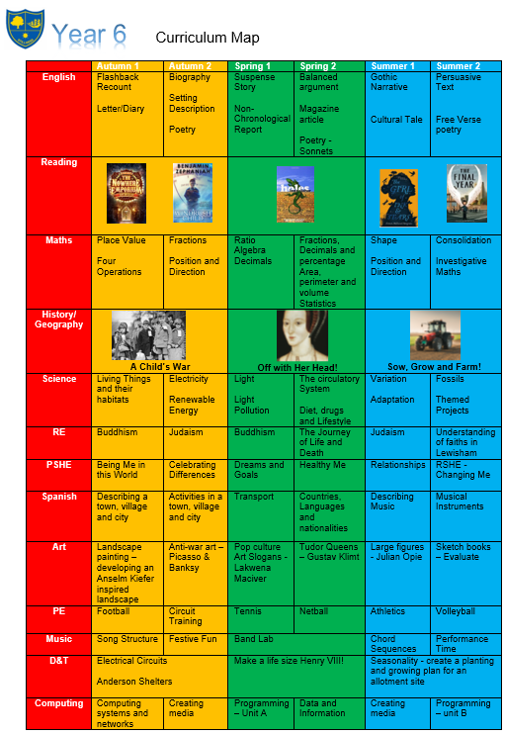

Curriculum Map
Year 6 is a rigorous year, and we have high expectations that all our pupils achieve the best of their ability.
Our main goal is that all children are exposed to a broad and engaging curriculum and leave us as well prepared for secondary school as possible.

Slide 6




Guided Reading Texts
Guided reading sessions will be based around the following texts. We encourage children to challenge themselves with the books they read at home and read widely across genres. The expectation is they read for 20-30 minutes per day.

Slide 7
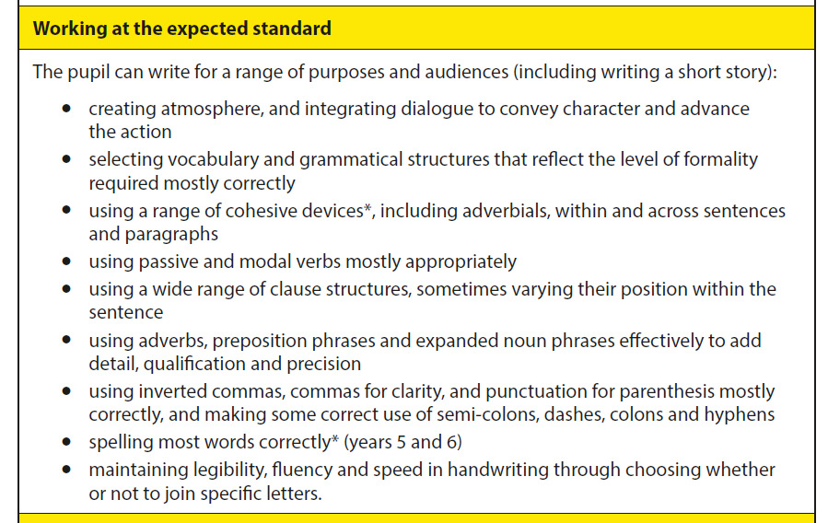
Writing Objectives

Slide 8
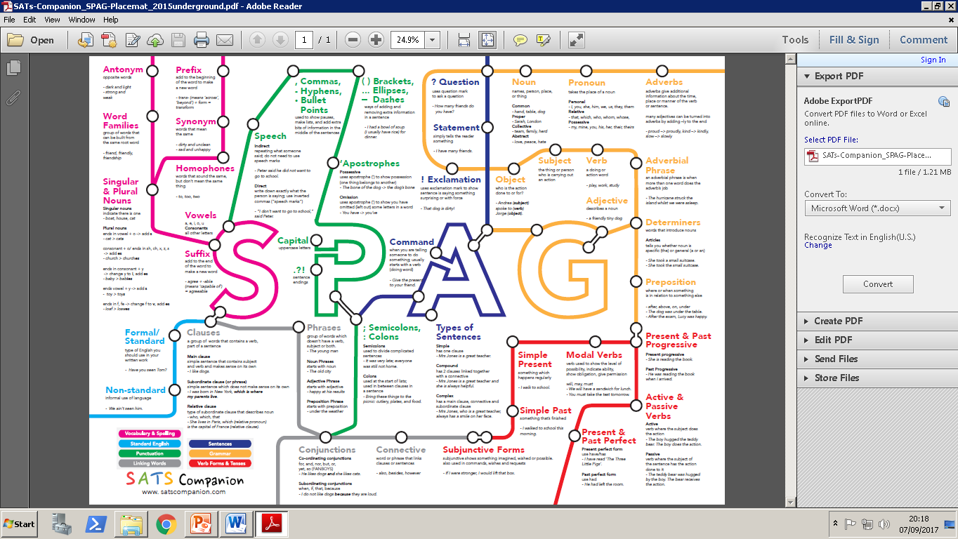
Spelling, Punctuation and Grammar

Slide 9
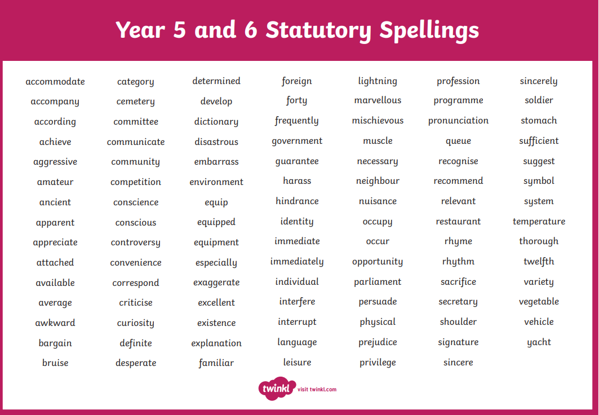
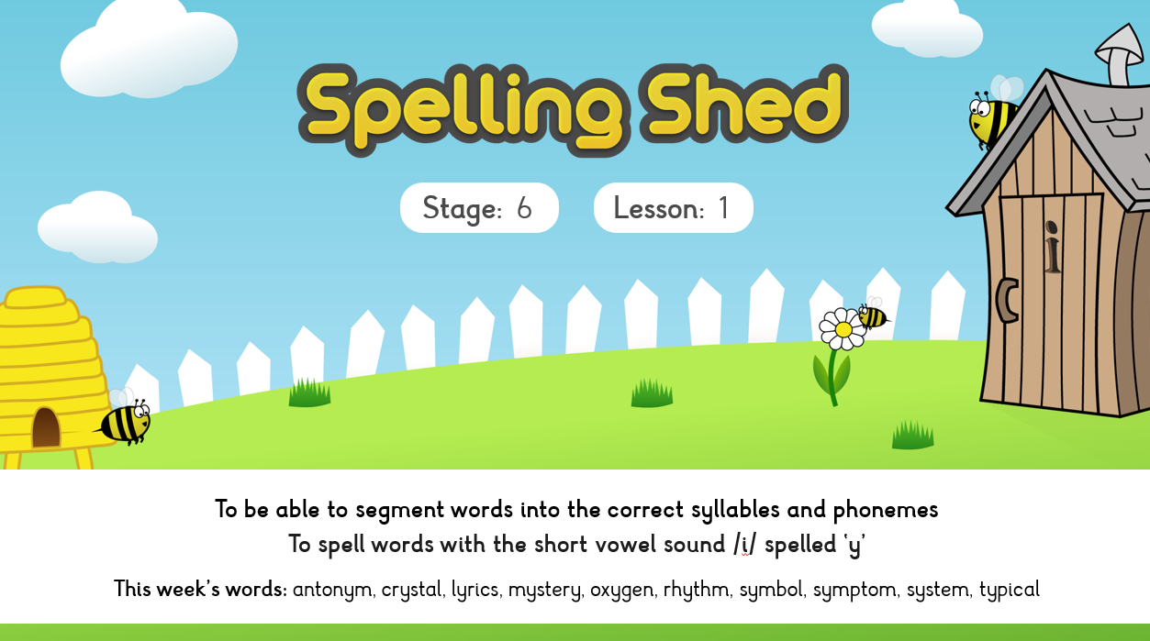
Spellings
This year we have changed our spelling programme. We will now be using Spelling Shed.
The weekly spellings are practiced daily during our lessons.
In addition, we encourage children to practise their spellings at home so they are ready for the test on Friday.

Slide 10
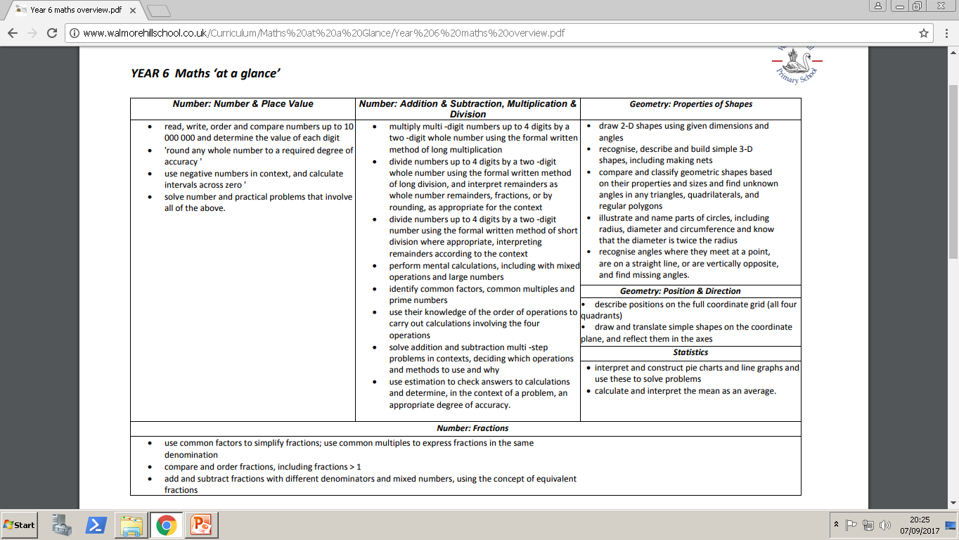
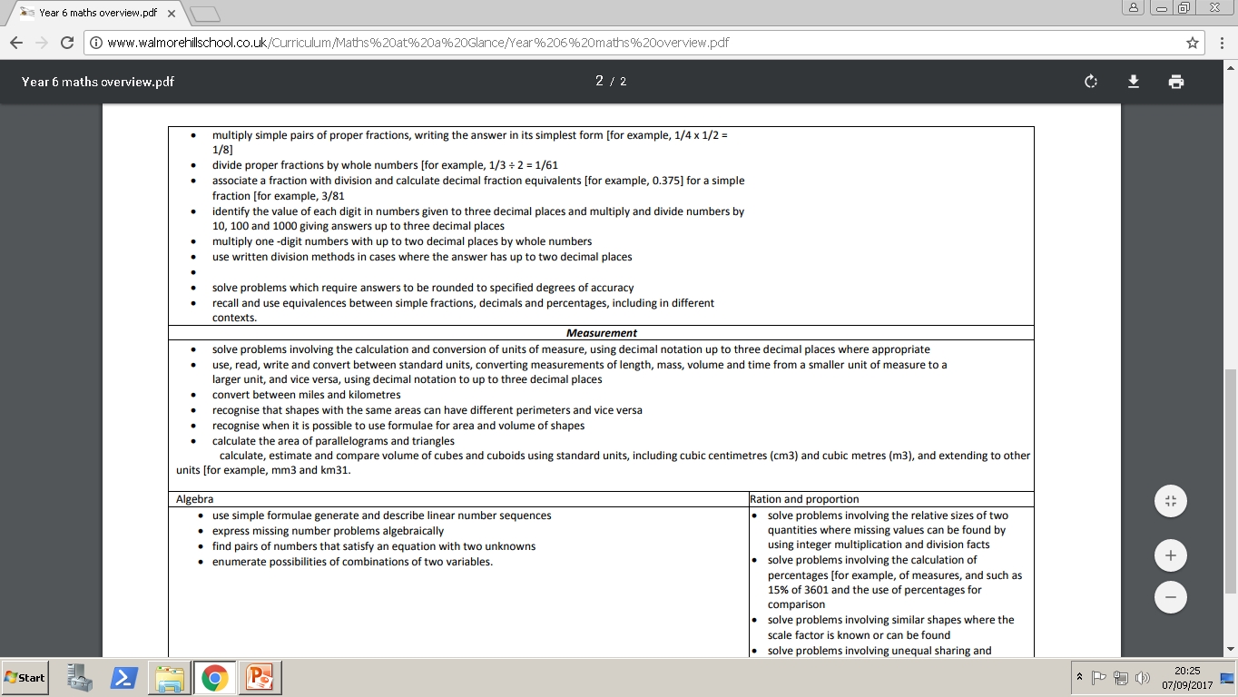
Maths Objectives
There are lots of maths objectives! Please look on our website for more information.

Slide 11






PE/Sporting Events
Coach Perry
Coach Joe

Slide 12
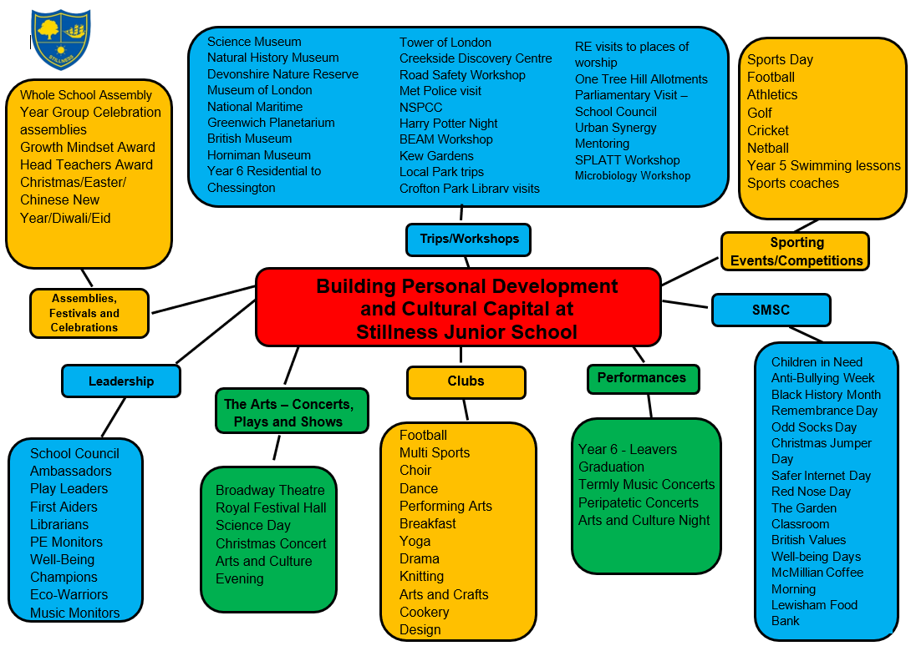
Cultural Capital
Autumn Trips
Catford Broadway Theatre (Keha Seebii and PANTO)
Imperial War Museum
SPLATT WWII immersive workshop
Buddhist Temple
Microbiology Workshop
PE Coaches
Spring Trips
Tower of London
Tudor Workshop
Dissecting of an animals heart
World Book Day
Science Day
Mental Health Workshop
Summer Trips
One Tree Hill Allotment
Natural History Museum
Sports Day
Residential trip to Chessington
Graduation
Arts and Culture Night
BEAM workshop
Transitions Workshop
Trip letters will be sent out with all information of the up-coming event.

Slide 13
Questions?
y6@stillnessjs.lewisham.sch.uk

Slide 14
SATs – Why are they important?
For schools:
The government and Ofsted use SATs results to assess school performance - helping to hold schools accountable.
The tests measure the progress pupils make from Key Stage 1 to Key Stage 2.
To support the transition from Primary school to Secondary school.
For students:
Secondary school placement: Many secondary schools use Year 6 SATs results to determine initial class sets or streams for new Year 7 students.
Future targets: The results are used to set targets for students' future GCSE grades, especially in English and maths.
Academic snapshot: The tests provide a snapshot of your child's academic progress at the end of primary school and can help identify areas where additional support might be needed.

Slide 15

SATs
Week beginning the Monday 11th May 2026.
We will have a further meeting during the Spring Term to go through the SATS arrangements, with detailed logistics.
Reading: 3 texts (1 hour)
GPS: Grammar and Punctuation (45 mins) Spelling (20 words)
Maths: 1 arithmetic paper (30 mins) and 2 reasoning papers (both 40 mins)
Tests reflect the National Curriculum for KS2 and are rigorous. They are marked independently, where a standardised score of 100 will mean your child is working at the expected standard.
Writing is judged through a moderation process.

Slide 16
Assessment Programme
We have 5 Assessment points in Year 6:
Baseline assessments: Week beginning 8th September - 2023 SATs papers
Autumn: Week beginning 1st December - 2022 SATs paper
Spring: Date TBC – 2025 SATs Paper
Summer MOCKS: Date TBC - 2024 SATs Paper
Summer: SATs - Week Beg: MONDAY 11TH MAY 2026

Slide 17
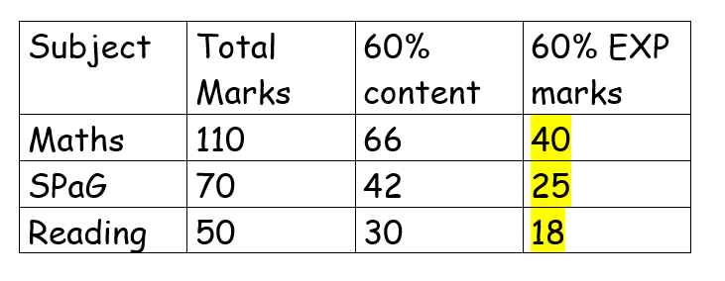
Baseline Assessment Information
Your child will be coming home with their assessment papers. Please celebrate all results.
Baseline expectations – 60% of 60%. I’ll explain what that means!
They have learnt 60% of the curriculum so far and to be working at the EXP level, they have to achieve 60%! We have broken this down to numerical values:
If your child has already exceeded the expectation, we will be challenging them with our GD programme. If your child, has not reached the expectation, we will be offering support in class as well as intervention programmes. In addition, we would advise completely the weekly homework.

Slide 18
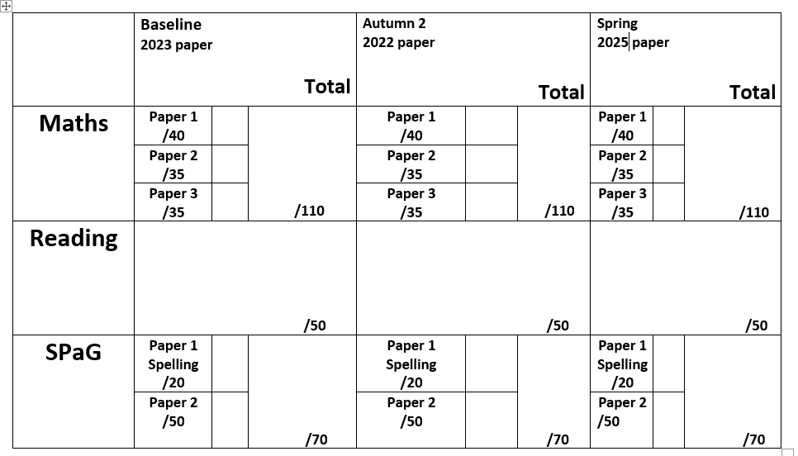
Reporting progress
Your child’s attainment and progress will be discussed with you at Parents Evening (10th and 11th December) using this document.

Slide 19
End of term assessment reports
Attainment: is the mark/level the child has achieved in the assessment.
At Stillness we use the following levels:
WTS – Working towards age-related expectations
EXP – Working at age-related expectations
GD – Greater Depth
Progress: is the progress made from the child’s individual starting point.
0 denotes Expected progress
+ a positive number denotes accelerated progress
a negative number denotes some progress

Slide 20
Questions?
y6@stillnessjs.lewisham.sch.uk

Slide 21
Secondary School Transition and Admissions
Our primary focus is to ensure that children are academically and emotionally prepared for secondary school, an aim that is supported by the curriculum throughout Year 6.
In the summer term we have a timetable of dedicated transition sessions and events that will reinforce the work we’ve done throughout the year.
Schools are currently holding open evenings – highly recommended you have a look around – however make sure you have read the schools admissions criteria. We are asking kindly that you do not see a school out of your catchment area or where you do not fit the criteria. This can be distressing for your child if they get their hopes up about a school they are unlikely to attend and absences in school can lead to gaps in their learning.
Visit Lewisham.gov.uk for admissions information.
You should register your decisions by 31st October via the website.

Slide 22
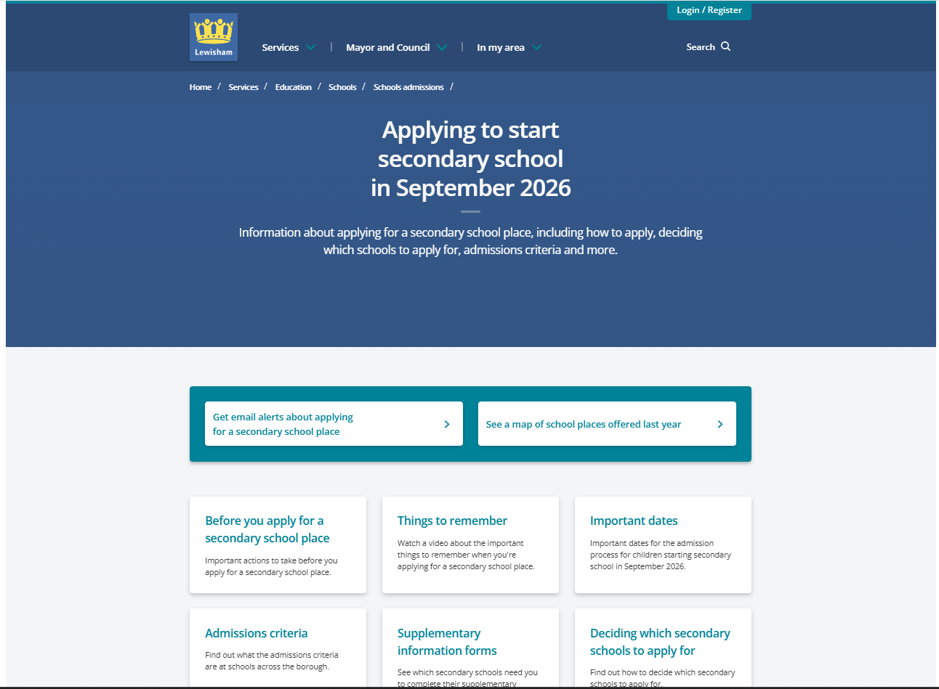
Admissions
Transition to Secondary School Event
22nd September 2025
This event will run in Lewisham’s Civic Suite from 5.00pm to 8pm.
We are expecting over 300 parents, who will attend one of the three talks which will concentrate on the application process. We hope the event will help to reduce the number of late applications received by the team each year, which often come from applicants where their children are already attending a Lewisham primary school. All Lewisham secondary schools will attend along with the following teams such as Free School Meal, SEN and the uniform shops.
Book tickets via Eventbrite.

Slide 23
Questions?
y6@stillnessjs.lewisham.sch.uk

Slide 24

Residential
Year 6 are off to Chessington!
It is located in Kingston Upon Thames, approx. 1.5 hours away.
We will be going on June 9th – 10th.
Ms Zelve will be sending out all information, so keep an eye out!
During the Spring Term we will hold a further meeting to give you more information.

Slide 25


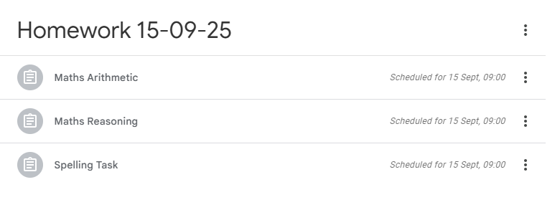
Daily reading and more reading!
Weekly maths, reading and SPaG tasks set on Google Classroom
Spellings – See website for list
TT Rockstars
SATS booster books – CGP books
Support at home

Slide 26
Here at Stillness Junior School we use a wide variety of communication tools to keep everyone informed.
Programme of Events: This is a detailed document outlining the trips that compliment our program of study.
Curriculum Newsletter: This termly communication from Year Group Leaders highlights specific information about the curriculum content.
Monthly Newsletter: This will be emailed out to you on the first day of the month.
Leadership Update: This is a weekly communication from Mrs Nichol, Headteacher and will be sent out every Tuesday. This communication will cover the upcoming week including events planned for the week.
Special Edition Newsletters: You will receive one newsletter a year from each subject leaders sharing information and resources about their subject.
Communication at Stillness

Slide 27
Pupil Premium Funding
The Pupil Premium Grant (PPG) is an allocation of additional funding from central government provided to schools to support specific groups of children who are vulnerable to possible under achievement. Those who are eligible for the grant include pupils who are entitled to free school meals (FSM), those looked after by the local authority (LAC), from households with no recourse to public funds (NRPF) and the children of armed service personnel.
You are entitled to FSM if the following applies to you:
your combined annual household income is below £16,190 (as assessed by HMRC) and you get one of the following benefits:
income-based: income support or jobseeker’s allowance (not eligible if on contribution based jobseeker’s allowance)
income-related: employment support allowance (not eligible if on contribution based employment support allowance)
universal credit
income support
the guaranteed element of state pension credit
support under Part VI of the Immigration and Asylum Act 1999
child tax credit only.
No recourse to public funds (NRPF) parents

Slide 28
Questions?
y6@stillnessjs.lewisham.sch.uk

