Slide 1

Welcome to Year 3!
Mrs Chisholm (Y3 Lead)
Miss Fatania
Miss Akinbobola (Teaching Assistant)
Mrs Renner-Thomas
Mrs Kelly ( Tuesdays)

Slide 2
REMINDERS
School starts at 8:45 and finishes at 3.30pm.
We are a uniform school!
PE will be on Monday and Friday.
Please check the school’s website for letters and information about the curriculum.

Slide 3






We are a uniform school!
Our school uniform consists grey skirts, culottes, trousers or shorts. Royal blue or yellow polo shirt, sweatshirt or fleece with or without the school logo. Children may wear blue or yellow check summer dresses. All pupils must wear black shoes or all black trainers. No leggings, tracksuit bottoms or cycle shorts please.
PE will be on Monday and Friday. Please come in wearing your school PE kit; white t-shirt, plain navy or black shorts, plain navy or black tracksuit (with or without the school logo) and black trainers. No leggings or cycling shorts please.
Note – During Sports Day, children will be asked to wear a t-shirt representing the colour of their house.
Children with hair longer than their shoulders should have it tied back and children should not wear any jewellery, with the exception of watches and stud earrings.
Uniform

Slide 4
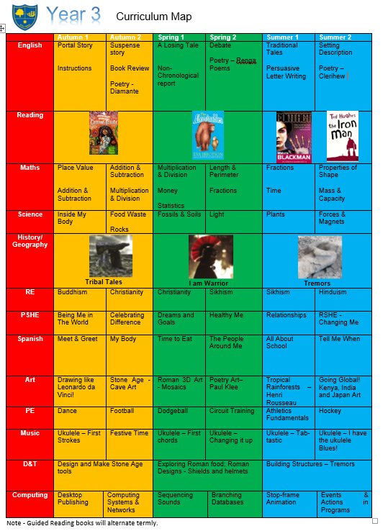
Curriculum Map
As your child transitions into Key Stage 2, our curriculum focuses on building ambitious, curious, and independent learners. In Maths, we follow the mastery-focused White Rose framework to embed deep problem-solving and reasoning skills. In English, we use reading texts and visual literacy to nurture confident readers, creative writers, and expressive communicators.
Our foundation subjects are brought to life through captivating, cross-curricular termly topics: "Tribal Tales" in Autumn, "I am Warrior" in Spring, and "Tremors" in Summer, perfectly pairing history and geography with scientific investigations into forces, magnets, light, and rocks. Alongside core academics, your child will also enjoy music and Art taught by specialist teachers and will benefit from two weekly PE lessons (including sessions with a specialist coach).
We are committed to using the rich cultural capital of London and our local Lewisham community to provide memorable learning experiences that broaden their horizons too!

Slide 5

Reading
Children will be issued with a Reading Scheme reading book. This should come in to school every day and in to the classroom. Please read this with them at home and write a comment in the Reading Record.
Children have borrowed a reading for pleasure book from the library which can be read to them or with them. Year 3 go to the library during the week with their class and will have the chance to change their books.

Slide 6




Guided Reading Texts

Slide 7
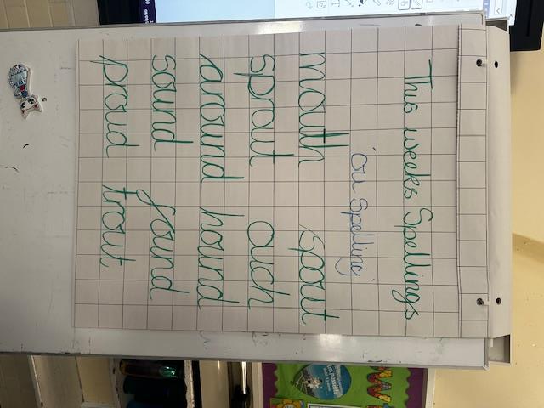
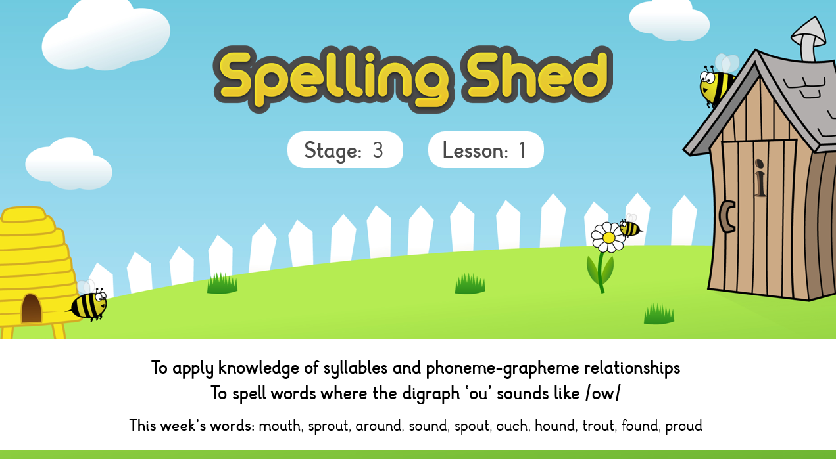
Spellings – Spelling Shed

Slide 8
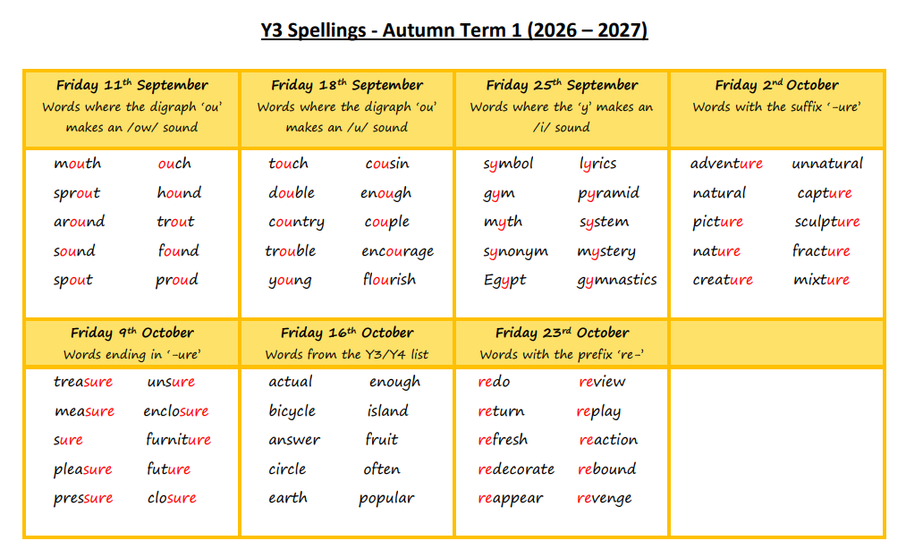
Spellings
The children will be given 10 spellings each week to learn in school and at home
Most set of spellings will follow a phonic or grammar rule
Every Friday the children will complete a spelling test in their English book
Week 1
The updated spelling document can be found on the school website in the English section.

Slide 9
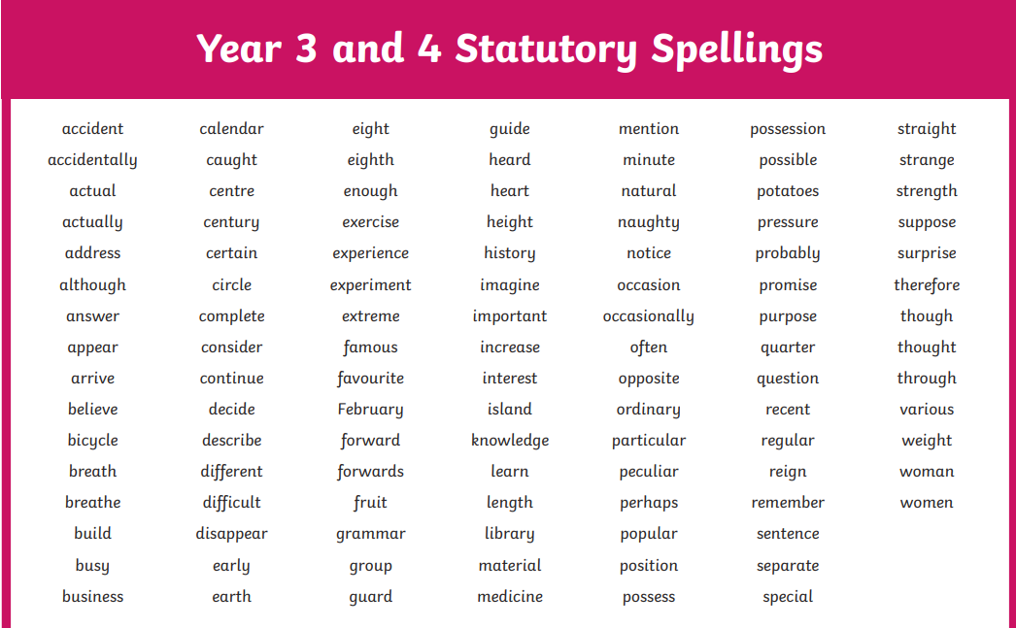
Learning and mastering the statutory Year 3 and 4 spelling words is vital, as these high-frequency terms build a robust vocabulary foundation that directly elevates the accuracy, sophistication, and confidence of your child's daily writing.

Slide 10







PE/Sporting Events
Coach Perry
Coach Joe

Slide 11
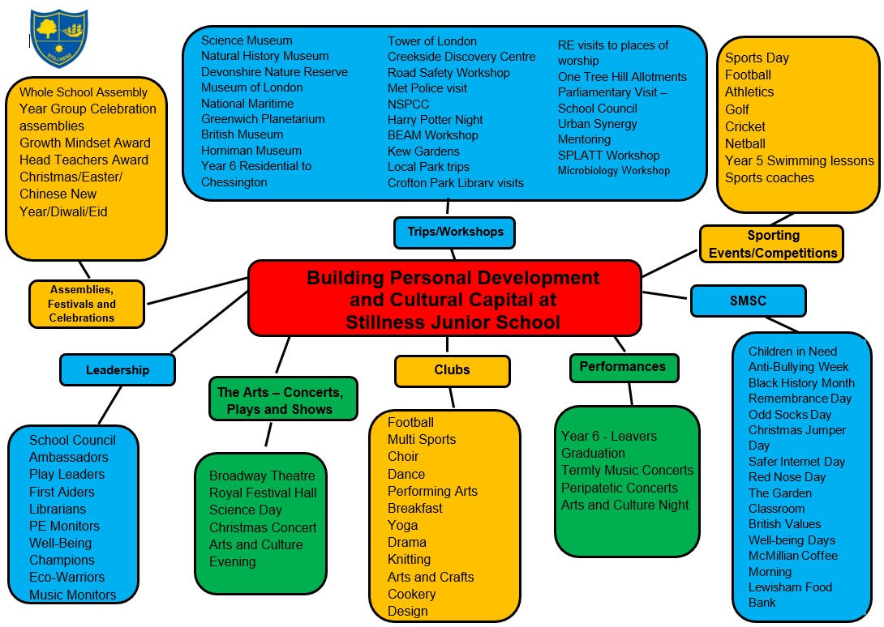
Cultural Capital
Enrichment
Cats protection workshop
Football training with the Tottenham coaches
Rocks, Fossils & Soils Workshop
DT workshop to the V&A Museum
Dress up days
Pantomime at Catford Broadway
Science Museum
Mitcham Zoo animal workshop
RE trips to churches and temples
Volcano building
Various DT projects in house
This year, driven by London’s universal free school meal entitlement, the school kitchen will automatically provide a complimentary packed lunch for every child attending the trip.

Slide 12
Roles and Responsibilities
Eco-warriors
First aiders
Well-being champions
Librarians
PE Monitor
Digital Leader
Classroom/Teaching Assistant Monitors
School Council Reps

Slide 13

SUPPORT AT HOME (homework)
Daily reading and more reading! It is the most important activity you can do with your child.
Spelling practice – shared on Monday with a test on a Friday
(10 spellings a week)
TT Rockstars (children will be given logins this week)
Times Table practice – you can practice on the way to school, before bed, at breakfast etc.
Look through the Knowledge Organisers – located on the school’s website
Enjoy the experiences our community has to offer and talk about them!
Please check the Year 3 curriculum letter for the Termly project.
‘Useful Links for parents’ can be found on Google Classroom.

Slide 14
Assessment
We have 3 Assessment points per academic year: Autumn, Spring and Summer
In Year 3 we have an additional baseline in the first month of Year 3.
Baseline: Children sit the KS1 SATs papers in Reading and Maths and we assess a piece of writing
Autumn: Week beginning 23rd November children sit papers in Reading and SPaG, White Rose Maths and we assess a piece of writing
Spring: Week beginning 1st March children sit papers in Reading and SPaG, White Rose Maths and we assess a piece of writing
Summer: Week beginning 28th June children sit papers in Reading and SPaG, White Rose Maths and we assess a piece of writing

Slide 15
Assessment
Attainment: is the mark/level the child has achieved in the assessment.
At Stillness we use the following levels:
WTS – Working towards age-related expectations
EXP – Working at age-related expectations
We do not use GD – Greater Depth in Years 3-5 as there is no official GD in those year groups. The only year groups where there is a definition of working at greater depth is in Year 2 and Year 6 where there are statutory assessments.
Progress: is the progress made from the child’s individual starting point. There will be no progress measure on the Autumn reports as progress is measured from Autumn to the following term.
0 denotes Expected progress
+ a positive number denotes accelerated progress
a negative number denotes some progress
Your child’s attainment and progress will be discussed with you at Parents Evening.

Slide 16
Class mixing
We mix classes at the end of each academic year. Teachers will use their in-depth knowledge of the children to build balanced, inclusive classrooms where every child has the opportunity to thrive academically, socially and emotionally. We will no longer be asking children to list choices of children they would like to remain in a class with as we have found that this has led to anxieties with both children and parents in making those choices. Each mix will be trialled in a variety of lessons to look at how the cohort will work together.
Year group teachers work together taking gender, ability, SEND, behaviour and friendships into account.
We appreciate your trust and partnership as we create a supportive environment for the new school year.

Slide 17
Pupil Premium Funding
The Pupil Premium Grant (PPG) is an allocation of additional funding from central government provided to schools to support specific groups of children who are vulnerable to possible under achievement. Those who are eligible for the grant include pupils who are entitled to free school meals (FSM), those looked after by the local authority (LAC), from households with no recourse to public funds (NRPF) and the children of armed service personnel.
Primary school children
If you receive benefits or tax credits, you should still apply for free school meals. This helps your child’s school receive additional government funding, known as the pupil premium, to support pupils' learning and wellbeing.
Children from households receiving Universal Credit with an annual earned income of £7,400 or less may be eligible for the pupil premium and other additional funding for their school.

Slide 18
COMMUNICATION y3@stillnessjs.lewisham.sch.uk – Please include your child’s name and class in the subject line
Response time: Within 2 working days admin@stillnessjs.lewisham.sch.uk – Any updates about absences, appointments etc…

Slide 19
Questions?

