Slide 1

Welcome to Year 4!
y4@stillnessjs.lewisham.sch.uk
Miss Rooney (Parbury Class teacher and Y4 Lead)
Ms Zelve (Sevenoaks Class teacher)
Mr Baxter (Ivy Class teacher)

Slide 2
REMINDERS
School starts at 8:45 and finishes at 3:30pm.
PE will be on Tuesday and Thursday mornings.
We visit the library as a class every week. Children can also visit the library at lunchtime during the week.
Please check the school’s website for letters and information about the curriculum.

Slide 3






We are a uniform school!
Our school uniform consists grey skirts, culottes, trousers or shorts. Royal blue or yellow polo shirt, sweatshirt or fleece with or without the school logo. Children may wear blue or yellow check summer dresses. All pupils must wear black shoes or all black trainers. No leggings, tracksuit bottoms or cycle shorts please.
PE will be on Tuesday and Thursday. Please come in wearing your school PE kit; white t-shirt, plain navy or black shorts, plain navy or black tracksuit (with or without the school logo) and black trainers. No leggings or cycling shorts please.
Note – During Sports Day, children will be asked to wear a t-shirt representing the colour of their house.
Children with hair longer than their shoulders should have it tied back and children should not wear any jewellery, with the exception of watches and stud earrings.
Uniform

Slide 4




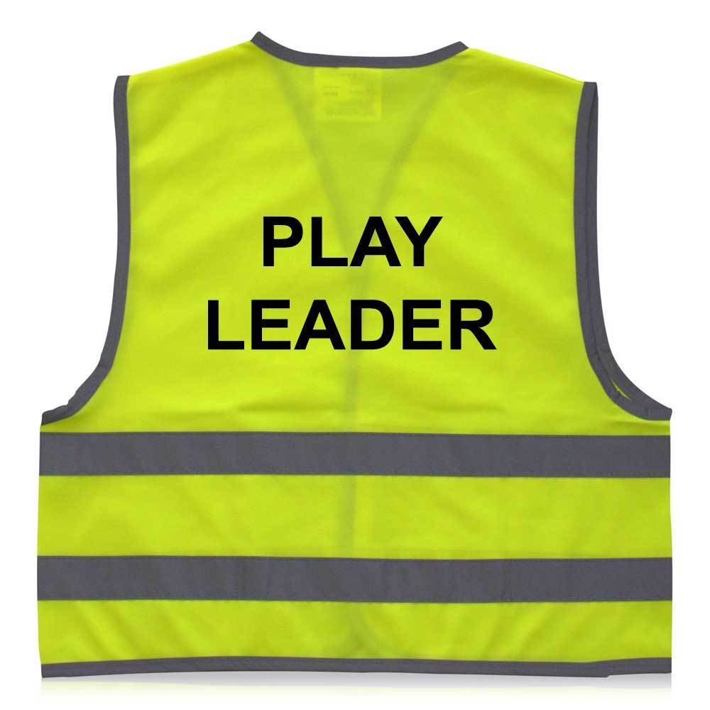
Roles and Responsibilities
At Stillness Junior School we have a number of roles and responsibilities at the school. At the beginning of the year we will speak to the children about the different roles and what their responsibility would be.
School Council
Play Leader
Librarian
PE Monitor
Music Monitor
First Aider
Computer Monitor
Wellbeing Champion
In class job roles

Slide 5
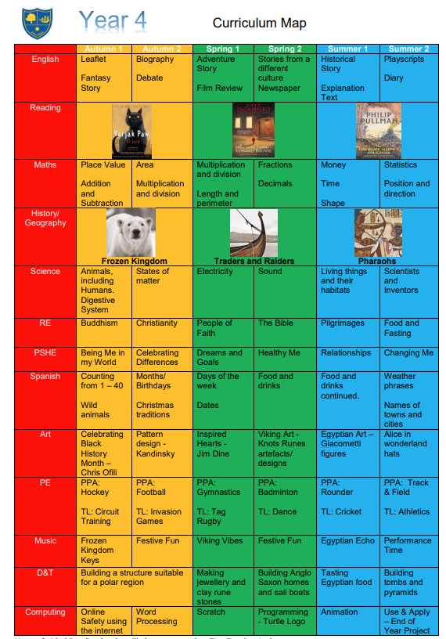
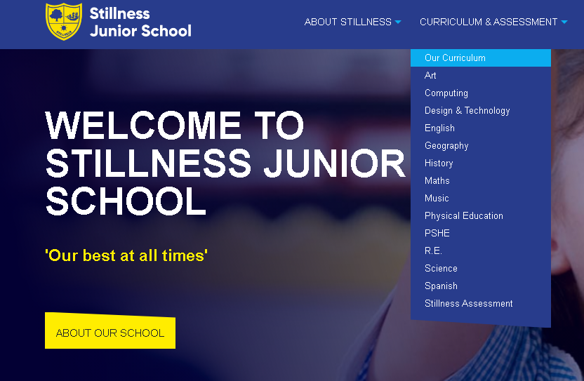
Curriculum Map
In Y4 we have high expectations of all our pupils to achieve to the best of their ability.
Our main goal is that all children are exposed to a broad and engaging curriculum.

Slide 6
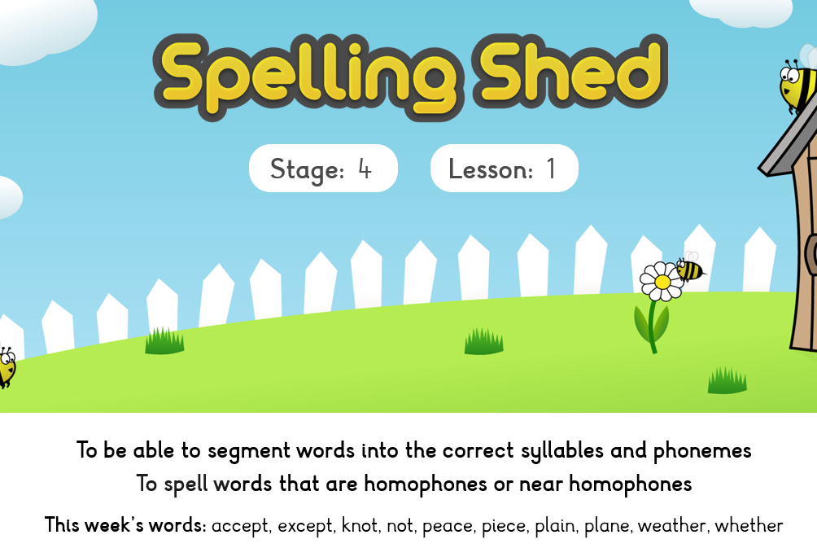
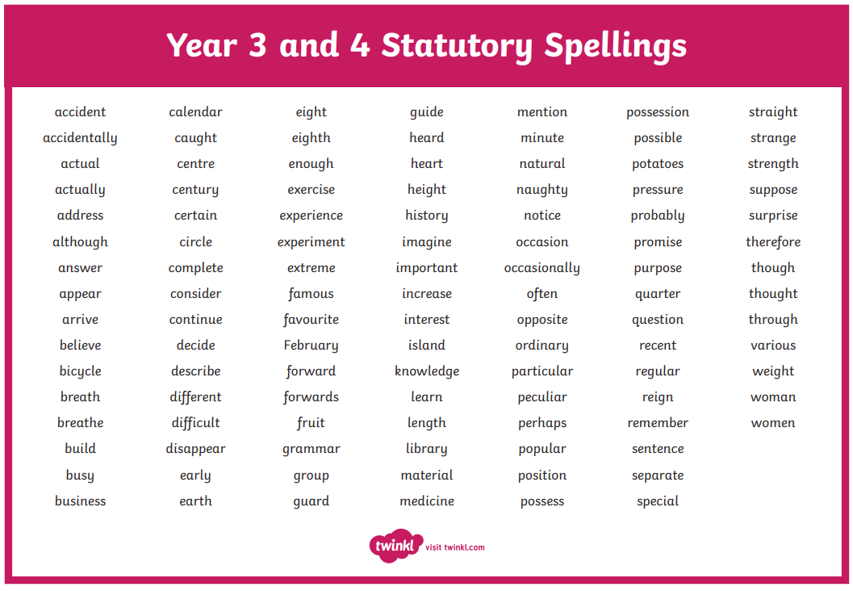
Spellings
In class we have a spelling activity at the start of each day.
The weekly spellings are displayed in the classroom.
We encourage children to practise their spellings at home so they are ready for the test on Friday.

Slide 7
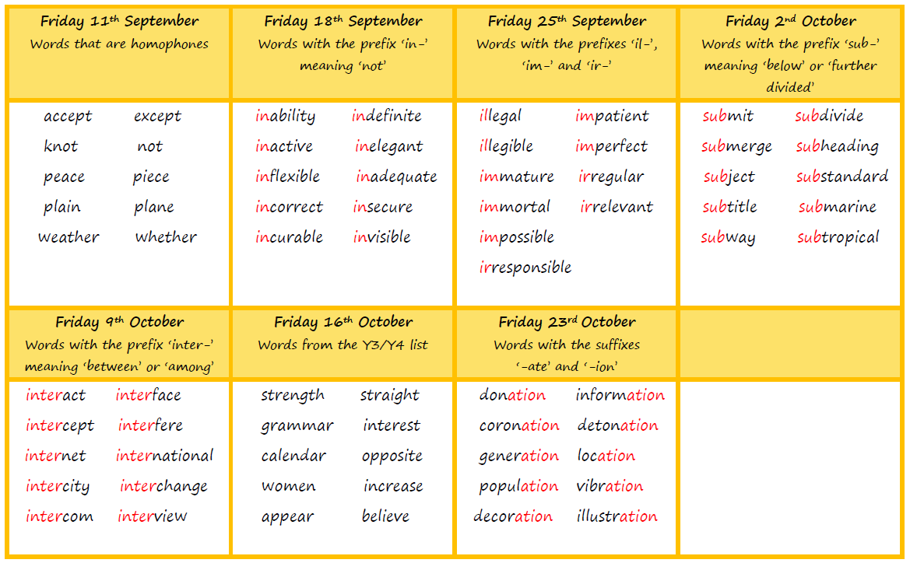
Spellings
The children are given 10 spellings each week to learn in school. We encourage children to learn them at home as well. Most sets of spellings over the year will follow a phonics or grammar rule. The children will complete a spelling test in their English book every Friday.
The spelling document is on the school website in the English section.

Slide 8




Guided Reading
Guided reading sessions will be based around these texts.
We start the week by reading a chapter of the book and we have a class discussion.
For the rest of the week, the children will answer VIPERS questions about the chapter they have read.

Slide 9
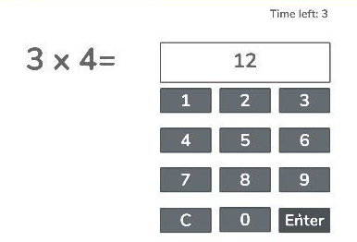
Multiplication Timetables Check (MTC)
In June all eligible Y4 children will be completing their MTC.
Children will be using chrome books
3 practise questions
25 questions
6 seconds to answer each question
The questions will only be multiplication and go up to 12x12
The results are not published publicly and there’s no pass or fail. The children will be told their score out of 25 in their Summer report.
x2 | x5 | x10 | x4 | x8 | x3 | x6 | x9 | x7 | x11 | x12
Suggested order to learn the tables (every child is different)

Slide 10
Multiplication Timestables Check (MTC)
Things we are doing in school
Times tables are taught weekly
TTRS is used weekly during our computing day
Early morning work focused on a specific times table
Children complete a Mock MTC each term
Things you can do at home
Encourage your child to use TTRS at home
Quiz your child regularly and at random on their times tables. This could be done whilst cooking, during car journeys or walking to school.
Use songs, games or rhymes to remember the tables
Challenge your child to ‘beat the adult’

Slide 11

SUPPORT AT HOME
Daily reading for at least 10 minutes.
Practise weekly spellings daily
TTRS – at least 3 times per week.
Look through the Knowledge Organisers – located on the school’s website
Enjoy the experiences our community has to offer and talk about them!
Please check the Y4 curriculum letter for the termly topic project.

Slide 12
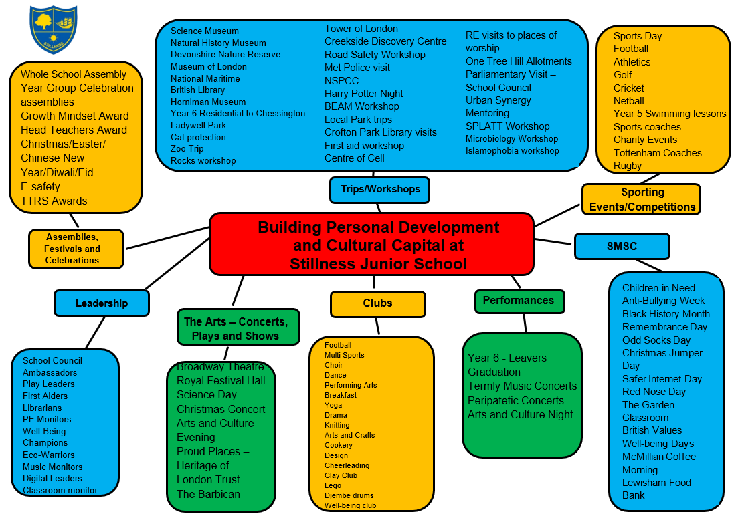
Y4 Enrichment Programme
PE run by specialist coaches
The Horniman museum to learn about Arctic life
The Maritime museum to learn about the Vikings
The British Museum to learn about Ancient Egypt
RE visits to a local synagogue, St Paul’s Cathedral and a local gurdwara
The Centre of the Cell to learn about the digestion system
Dress up days
Pantomime at Catford Broadway
Various D&T projects and Science investigations in school
This year, driven by London’s universal free school meal entitlement, the school kitchen will automatically provide a complimentary packed lunch for every child attending the trip.

Slide 13
Assessment
We have 3 Assessment points per academic year: Autumn, Spring and Summer
Autumn: Week beginning 23rd November children sit papers in Reading and SPaG, White Rose Maths and we assess a piece of writing
Spring: Week beginning 1st March children sit papers in Reading and SPaG, White Rose Maths and we assess a piece of writing
Summer: Week beginning 28th June children sit papers in Reading and SPaG, White Rose Maths and we assess a piece of writing

Slide 14
Assessment
Attainment: is the mark/level the child has achieved in the assessment.
At Stillness we use the following levels:
WTS – Working towards age-related expectations
EXP – Working at age-related expectations
We do not use GD – Greater Depth in Years 3-5 as there is no official GD in those year groups. The only year groups where there is a definition of working at greater depth is in Year 2 and Year 6 where there are statutory assessments.
Progress: is the progress made from the child’s individual starting point. There will be no progress measure on the Autumn reports as progress is measured from Autumn to the following term.
0 denotes Expected progress
+ a positive number denotes accelerated progress
a negative number denotes some progress
Your child’s attainment and progress will be discussed with you at Parents Evening.

Slide 15
Class mixing
We mix classes at the end of each academic year. Teachers will use their in-depth knowledge of the children to build balanced, inclusive classrooms where every child has the opportunity to thrive academically, socially and emotionally. We will no longer be asking children to list choices of children they would like to remain in a class with as we have found that this has led to anxieties with both children and parents in making those choices. Each mix will be trialled in a variety of lessons to look at how the cohort will work together.
Year group teachers work together taking gender, ability, SEND, behaviour and friendships into account.
We appreciate your trust and partnership as we create a supportive environment for the new school year.

Slide 16
Pupil Premium Funding
The Pupil Premium Grant (PPG) is an allocation of additional funding from central government provided to schools to support specific groups of children who are vulnerable to possible under achievement. Those who are eligible for the grant include pupils who are entitled to free school meals (FSM), those looked after by the local authority (LAC), from households with no recourse to public funds (NRPF) and the children of armed service personnel.
Primary school children
If you receive benefits or tax credits, you should still apply for free school meals. This helps your child’s school receive additional government funding, known as the pupil premium, to support pupils' learning and wellbeing.
Children from households receiving Universal Credit with an annual earned income of £7,400 or less may be eligible for the pupil premium and other additional funding for their school.

Slide 17
Questions?

Slide 18
COMMUNICATION
y4@stillnessjs.lewisham.sch.uk
admin@stillnessjs.lewisham.sch.uk

