Slide 1

Welcome to Year 6!
Mrs Threadgold
Ms Beeke
Mrs Kelly
Mrs Mclean
Miss Winter
Miss Brown

Slide 2
School starts at 8:45am and we dismiss at 3.30pm.
If you would like your child to walk home alone – you must update your permission.
The behaviour system remains the same, with children being awarded a house point for demonstrating the agreed behaviour expectations and consequences will be in line with our behaviour policy.
As many children walk home by themselves, we understand that parents want to be able to be in contact with children. However, please note that we have a no phone policy for safeguarding purposes. If pick-up arrangements change, please contact the office.
Expectations and Routines

Slide 3






We are a uniform school!
Our school uniform consists grey skirts, culottes, trousers or shorts. Royal blue or yellow polo shirt, sweatshirt or fleece with or without the school logo. Children may wear blue or yellow check summer dresses. All pupils must wear black shoes or all black trainers. No leggings, tracksuit bottoms or cycle shorts please.
PE will be on Tuesdays and Wednesdays. Please come in wearing your school PE kit; white t-shirt, plain navy or black shorts, plain navy or black tracksuit (with or without the school logo) and black trainers. No leggings or cycling shorts please.
Note – During Sports Day, children will be asked to wear a t-shirt representing the colour of their house.
Children with hair longer than their shoulders should have it tied back and children should not wear any jewellery, with the exception of watches and stud earrings.
Uniform

Slide 4





Roles and Responsibilities
At Stillness Junior School we have a number of roles and responsibilities. At the beginning of the year we will speak to each children about the different roles and what that entails, so they are aware of the responsibility for that role.
House Captains
Ambassador ( Year 6)
Peer Mediators ( Year 6)
School Council
Play Leader
Librarian
PE Monitor
Music Monitor
First Aider
Well-being Champion
Classroom Monitors
Eco-warriors
Digital Leaders
Ambassador ( Year 6)
Peer Mediators ( Year 6)
School Council
Play Leader
Librarian
PE Monitor
Music Monitor
First Aider
Wellbeing Champion
In class job roles

Slide 5
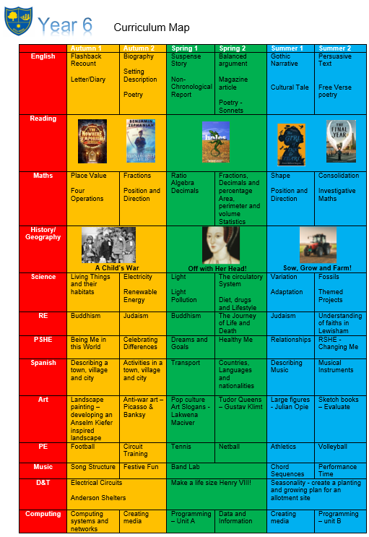

Curriculum Map
Year 6 is a rigorous year, and we have high expectations that all our pupils achieve the best of their ability.
Our main goal is that all children are exposed to a broad and engaging curriculum and leave us as well prepared for secondary school as possible.

Slide 6
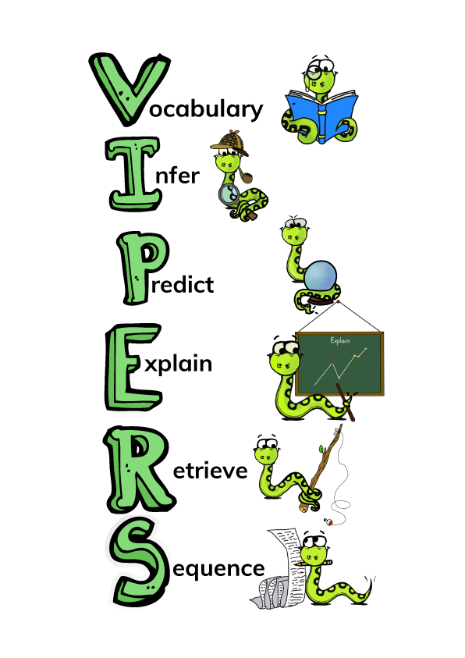





Guided Reading Texts
Guided reading sessions will be based around the following texts.
At home, we encourage children to challenge themselves with the books they read and read widely across genres. The expectation is they read for 20-30 minutes per day.

Slide 7
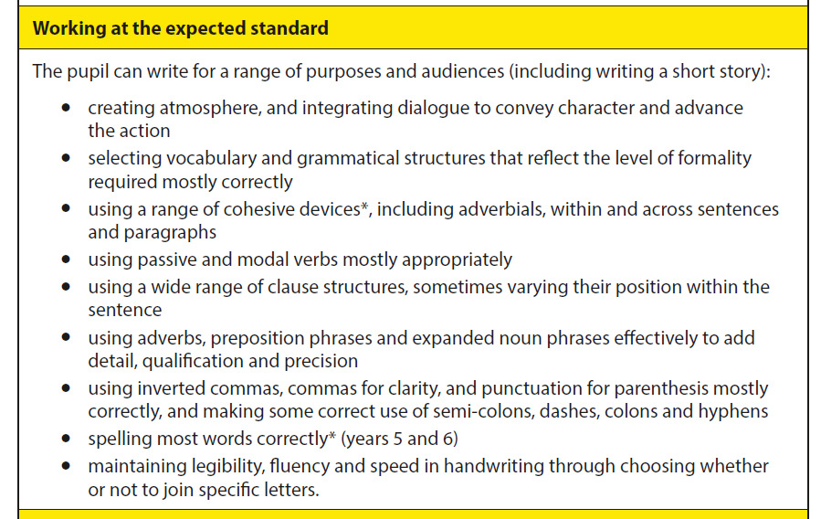
Writing Objectives

Slide 8
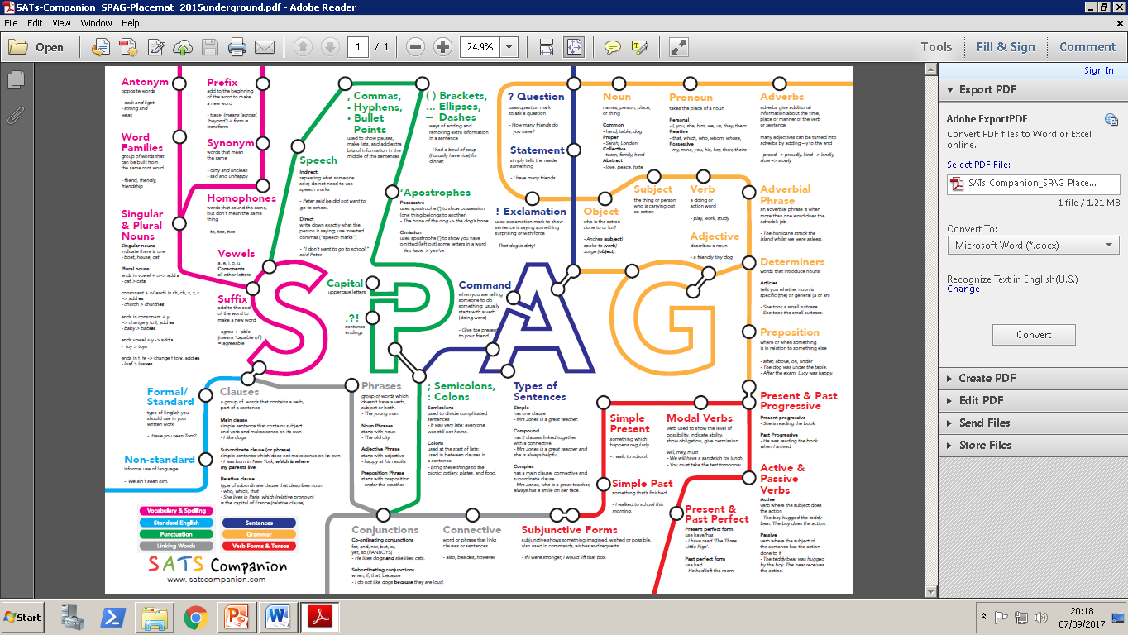
Spelling, Punctuation and Grammar

Slide 9
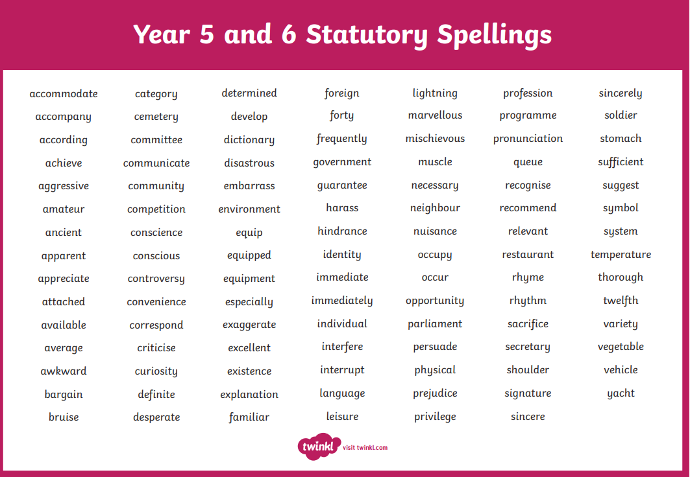
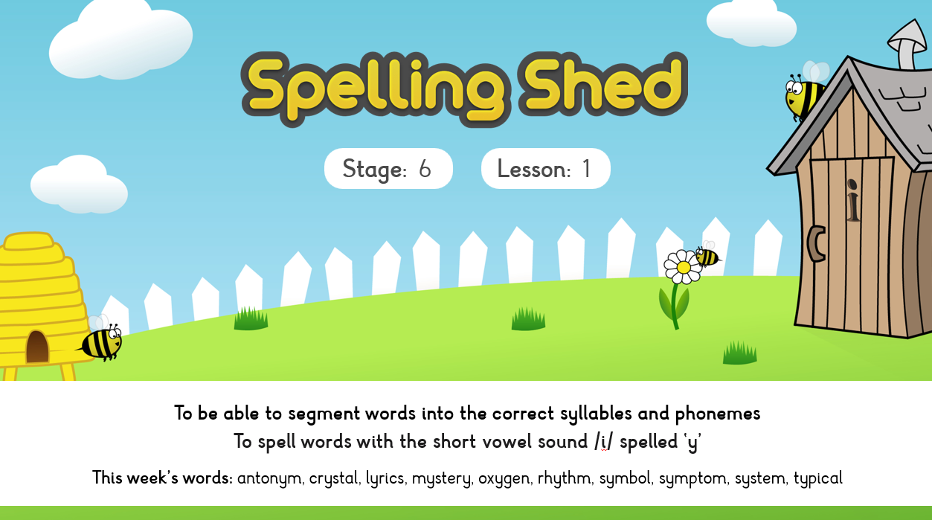
Spellings
We are continuing to use Spelling Shed.
The weekly spellings are practiced daily during our lessons.
In addition, we encourage children to practise their spellings at home so they are ready for the test on Friday and there will be a weekly activity published on google classroom as part of your child’s homework.

Slide 10
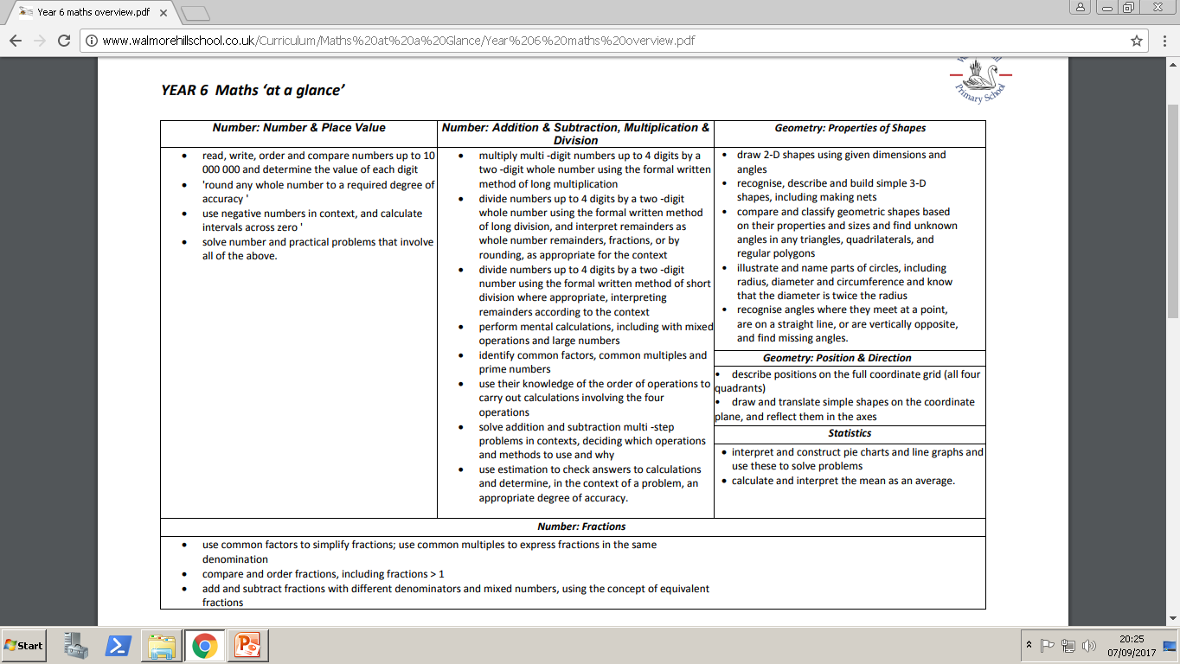
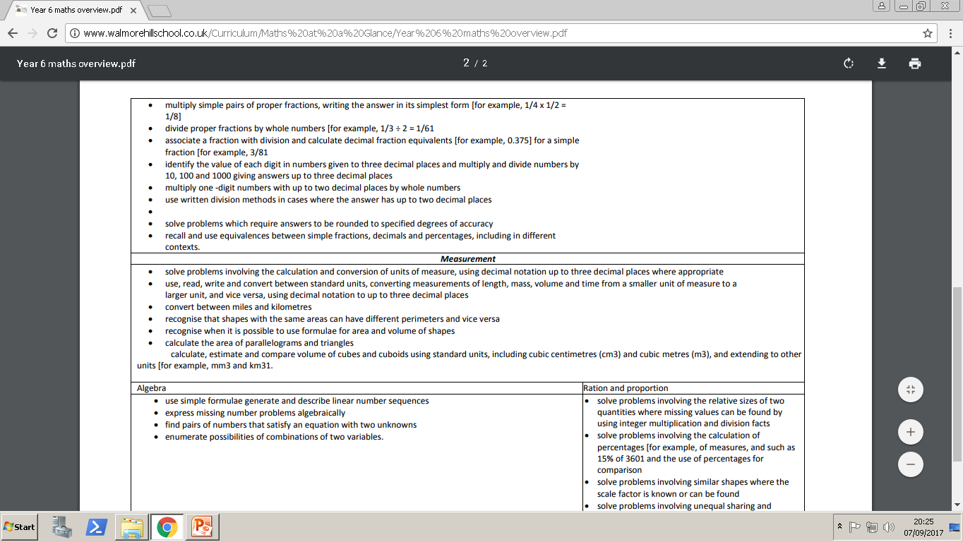
Maths Objectives
There are lots of maths objectives! Please look on our website for more information.

Slide 11






PE/Sporting Events
Coach Perry
Coach Joe

Slide 12
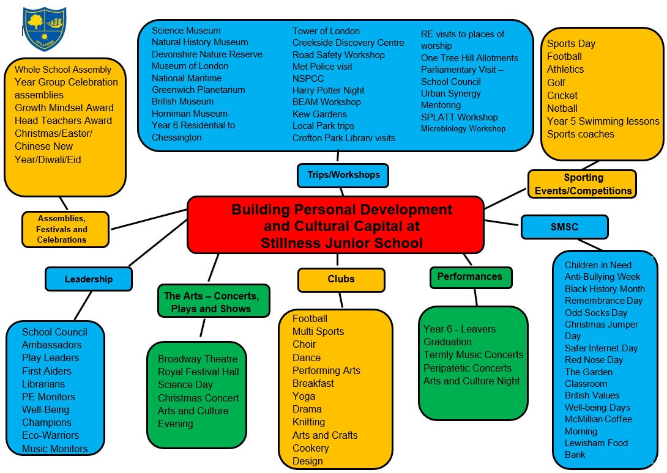
Cultural Capital
Autumn Trips
Catford Broadway Theatre (PANTO)
Imperial War Museum
SPLATT WWII immersive workshop
Buddhist Temple
Microbiology Workshop
PE Coaches
Spring Trips
Tower of London
Dissecting of an animal’s heart
World Book Day
Science Day
Summer Trips
One Tree Hill Allotment
Natural History Museum
Sports Day
Maths Day
Residential trip to Hindleap
Graduation
Arts and Culture Night
BEAM workshop
Transitions Workshop

Slide 13
SATs – Why are they important?
For schools:
The government and Ofsted use SATs results to assess school performance - helping to hold schools accountable.
The tests measure the progress pupils make from Key Stage 1 to Key Stage 2.
To support the transition from Primary school to Secondary school.
For students:
Secondary school placement: Many secondary schools use Year 6 SATs results to determine initial class sets or streams for new Year 7 students.
Future targets: The results are used to set targets for students' future GCSE grades, especially in English and maths.
Academic snapshot: The tests provide a snapshot of your child's academic progress at the end of primary school and can help identify areas where additional support might be needed.

Slide 14

SATs
Week beginning the Monday 10th May 2027.
We will have a further meeting during the Spring Term to go through the SATS arrangements, with detailed logistics.
Reading: 3 texts (1 hour)
GPS: Grammar and Punctuation (45 mins) Spelling (20 words)
Maths: 1 arithmetic paper (30 mins) and 2 reasoning papers (both 40 mins)
Tests reflect the National Curriculum for KS2 and are rigorous. They are marked independently, where a standardised score of 100 will mean your child is working at the expected standard.
Writing is judged through a moderation process.

Slide 15
Assessment Programme
We have 5 Assessment points in Year 6:
Baseline assessments: Week beginning 7th September - 2023 SATs papers
Autumn: Week beginning 30th November - 2024 SATs paper
Spring: Date TBC – 2025 SATs Paper
Summer MOCKS: Date TBC - 2026 SATs Paper
Summer: SATs - Week Beg: MONDAY 10TH MAY 2027

Slide 16
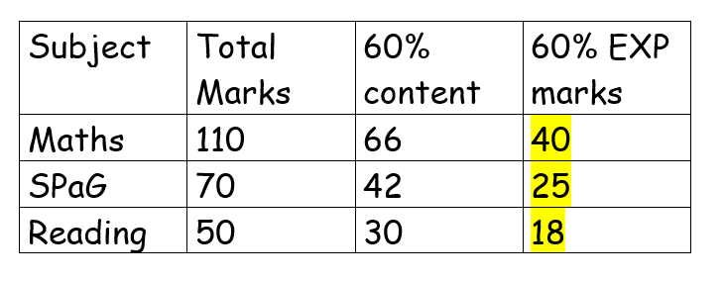
Baseline Assessment Information
Your child will be coming home with their assessment papers. Please celebrate all results.
Baseline expectations – 60% of 60%. I’ll explain what that means!
They have learnt 60% of the curriculum so far and to be working at the EXP level, they have to achieve 60%! We have broken this down to numerical values:
If your child has already exceeded the expectation, we will be challenging them with our GD programme. If your child, has not reached the expectation, we will be offering support in class as well as intervention programmes. In addition, we would advise completing the weekly homework.

Slide 17
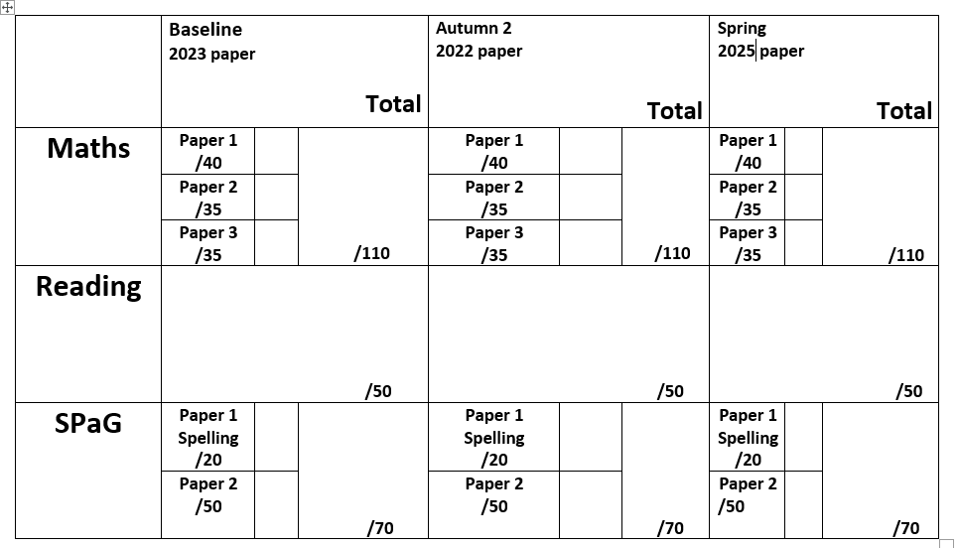
Reporting progress
Your child’s attainment and progress will be discussed with you at Parents Evening (9th and 10th December) using this document.

Slide 18
End of term assessment reports
Attainment: is the mark/level the child has achieved in the assessment.
At Stillness we use the following levels:
WTS – Working towards age-related expectations
EXP – Working at age-related expectations
GD – Greater Depth
Progress: is the progress made from the child’s individual starting point.
0 denotes Expected progress
+ a positive number denotes accelerated progress
a negative number denotes some progress

Slide 19
Secondary School Transition and Admissions
Our primary focus is to ensure that children are academically and emotionally prepared for secondary school, an aim that is supported by the curriculum throughout Year 6.
In the summer term we have a timetable of dedicated transition sessions and events that will reinforce the work we’ve done throughout the year.
Schools are currently holding open evenings – highly recommended you have a look around – however make sure you have read the schools admissions criteria. We are asking kindly that you do not see a school out of your catchment area or where you do not fit the criteria. This can be distressing for your child if they get their hopes up about a school they are unlikely to attend and absences in school can lead to gaps in their learning.
Visit Lewisham.gov.uk for admissions information.
You should register your decisions by 31st October via the website.

Slide 20
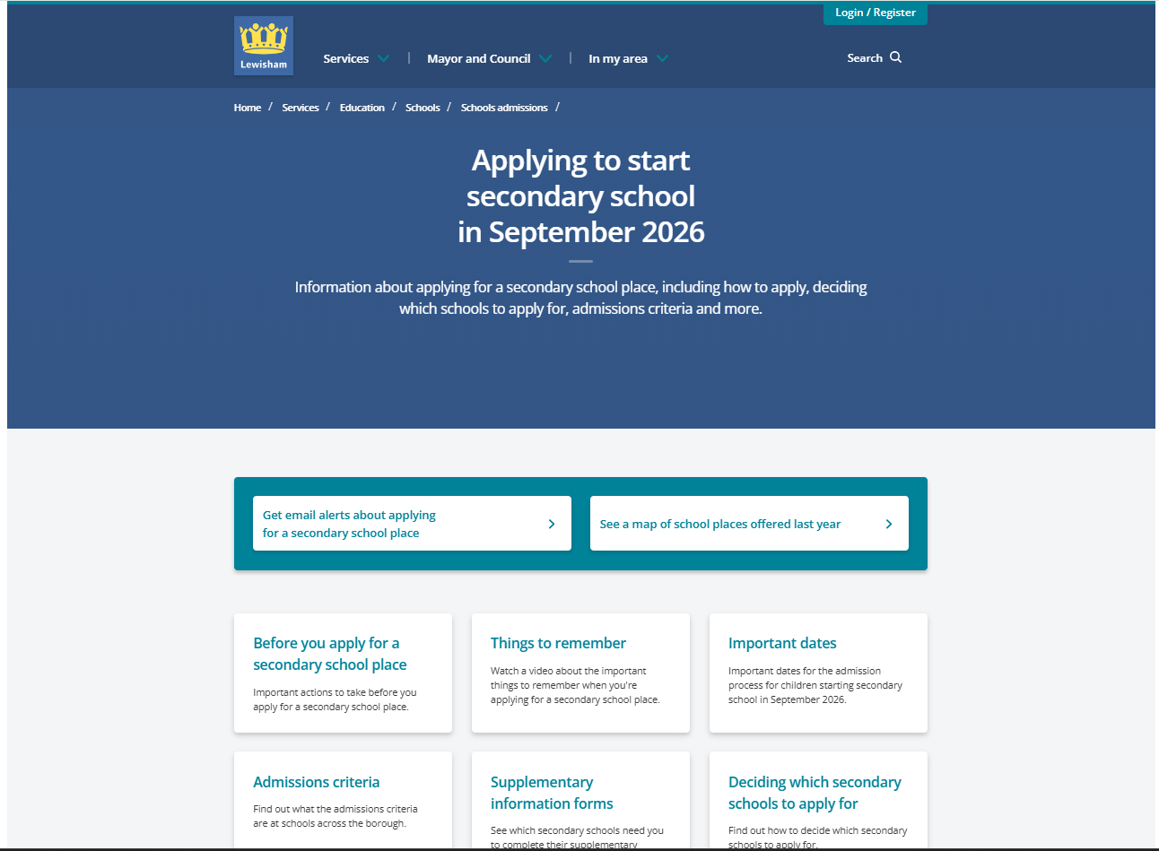
Admissions

Slide 21

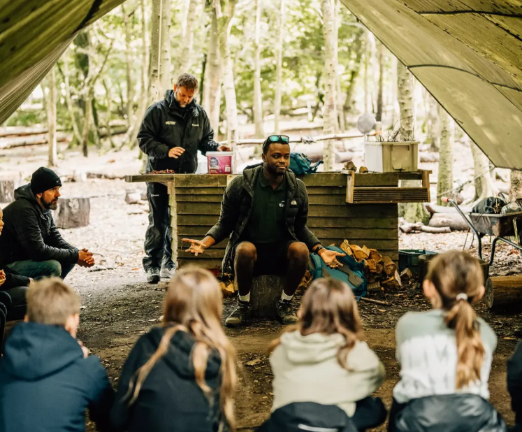
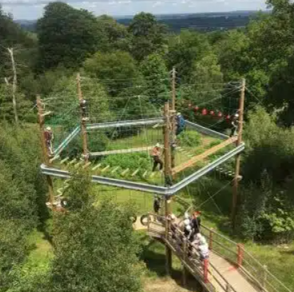
Residential
Year 6 are off to Hindleap!
It is located in Ashdown Forest, East Sussex approx. 1.5 hours away.
We will be going on July 5th – 6th.
Ms Zelve will be sending out all information, so keep an eye out!
During the Spring Term we will hold a further meeting to give you more information.

Slide 22


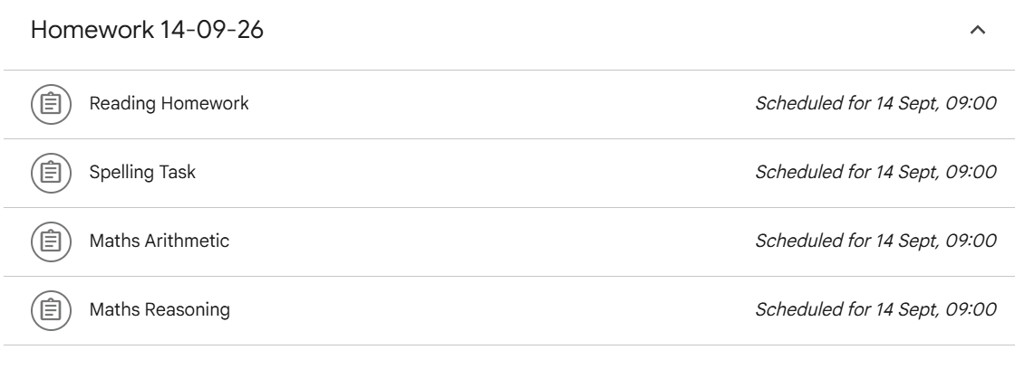
Daily reading and more reading!
Homework (encouraged) - Weekly maths, reading and spelling tasks set on Google Classroom
Spellings to learn – See website for list – tested on Fridays
Curriculum Newsletter projects
TT Rockstars
Edshed Spellings
SATS booster books – CGP books
Support at home

Slide 23
Here at Stillness Junior School we use a wide variety of communication tools to keep everyone informed.
Programme of Events: This is a detailed document outlining the trips that compliment our program of study.
Curriculum Newsletter: This termly communication from Year Group Leaders highlights specific information about the curriculum content.
Monthly Newsletter: This will be emailed out to you on the first day of the month.
Leadership Update: This is a weekly communication from Mrs Nichol, Headteacher and will be sent out every Tuesday. This communication will cover the upcoming week including events planned for the week.
Special Edition Newsletters: You will receive one newsletter a year from each subject leaders sharing information and resources about their subject.
Communication at Stillness

Slide 24
Pupil Premium Funding
The Pupil Premium Grant (PPG) is an allocation of additional funding from central government provided to schools to support specific groups of children who are vulnerable to possible under achievement. Those who are eligible for the grant include pupils who are entitled to free school meals (FSM), those looked after by the local authority (LAC), from households with no recourse to public funds (NRPF) and the children of armed service personnel.
Primary school children
If you receive benefits or tax credits, you should still apply for free school meals. This helps your child’s school receive additional government funding, known as the pupil premium, to support pupils' learning and wellbeing.
Children from households receiving Universal Credit with an annual earned income of £7,400 or less may be eligible for the pupil premium and other additional funding for their school.

Slide 25
Questions?
y6@stillnessjs.lewisham.sch.uk

